Slide 1
Are Younger Americans Less Religious? Unearthing Old Ground with Novel Methods
Simon G. Brauer, Ph.D.
Institute for Social Research, University of Michigan
Annual Meeting of the Society for the Scientific Study of Religion
November 13th, 2022
Slides and recording available at www.simonbrauer.us

Slide 2
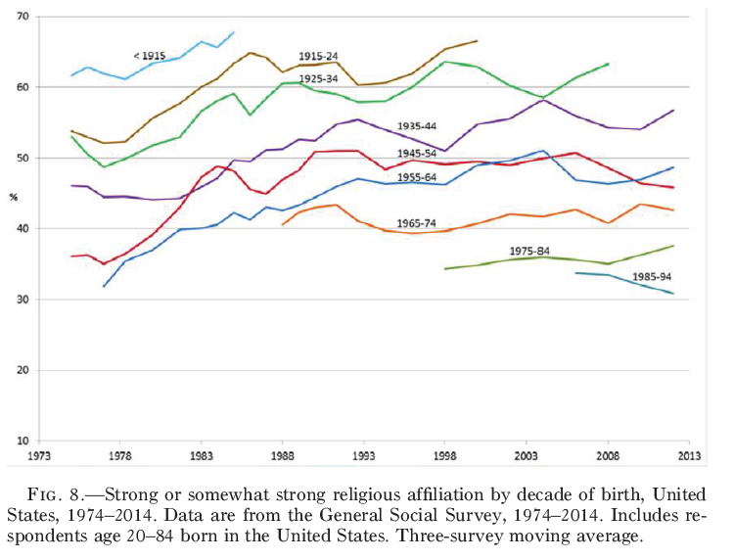
Descriptive approaches
Voas and Chaves 2016 (p. 1,542)
Schnabel and Bock 2018 (p. 715)

Slide 3
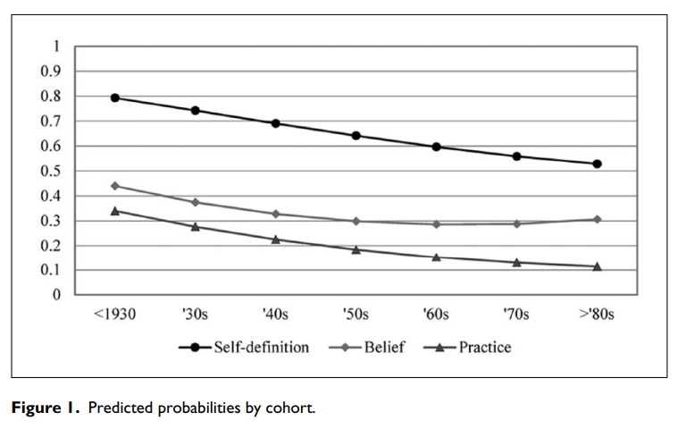
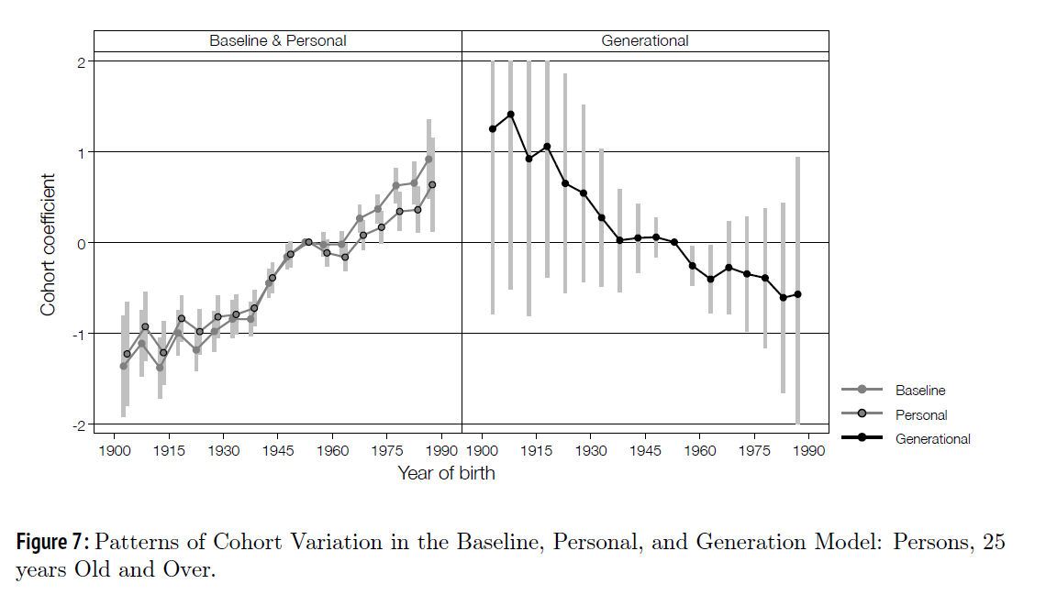
Analytic approaches
Molteni and Biolcati 2018 (p. 425)
Hout and Fischer 2014 (p. 438)

Slide 4
What even is a “cohort effect”?
Theoretical explanation sounds great… …analytical solutions and explanations less so

Slide 5
Indeterminancy
Typical “matrix algebra land” illustration
$$period=cohort+age$$
Alternative “counterfactual land” illustration
$$μ_{c,a}=α_{c}^{C}+\sum_{i=c}^{c+a}{α_{i}^{P}+\sum_{j=1}^{a}{α_{j}^{A}}}$$
$$μ_{c,a}−μ_{c−1,a}=…$$

Slide 6
Indeterminancy
$$μ_{c,a}−μ_{c−1,a}=$$
$$\left(α_{c}^{C}−α_{c−1}^{C}\right)+{(α}_{c+a}^{P}−α_{c−1}^{P})$$
$$α_{6}^{C}$$
6
$$α_{6−9}^{P}$$
6
7
8
9
$$μ_{6,4}$$
$$α_{1−4}^{A}$$
1
2
3
4
$$−$$
$$α_{5}^{C}$$
5
$$α_{5−8}^{P}$$
5
6
7
8
$$μ_{5,4}$$
$$α_{1−4}^{A}$$
1
2
3
4

Slide 7
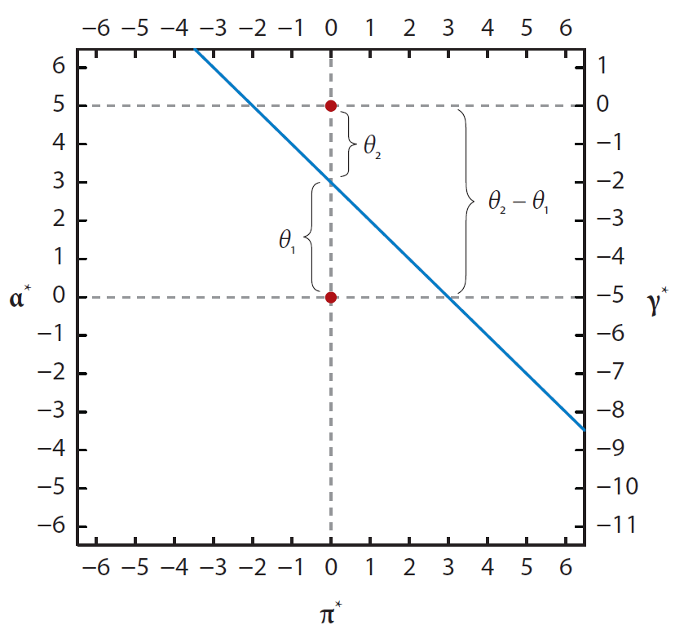
Can you find cohort effects?
Fosse and Winship 2019 (p. 483)
Problem 1: Fundamental problem of APC
$$period=cohort+age$$
Problem 2: More complex models (e.g. H-APC, intrinsic estimator) do not get around the issue of an infinite number of solutions (Fosse and Winship 2019)

Slide 8
Taking the easy way out
Are younger cohorts less religious than older cohorts?
Is the cohort effect for cohort $t$ lower than the cohort effect for cohort $t−1$?
Is the actual observed/estimated religiousness of cohort $t$ consistently lower than the observed/estimated religiousness of cohort $t−25$ at the same age?
$$μ_{c,a}−μ_{c−25,a}<0$$

Slide 9
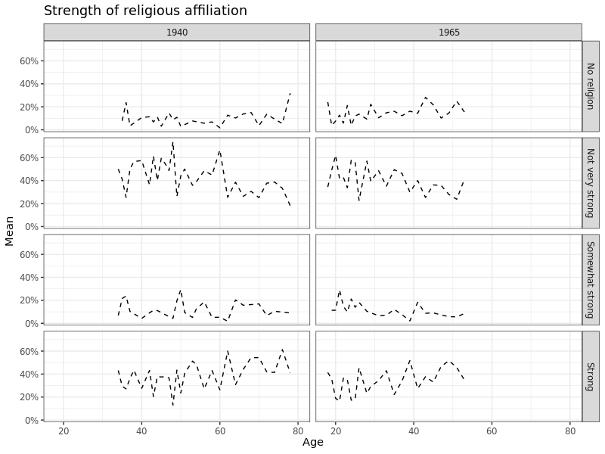
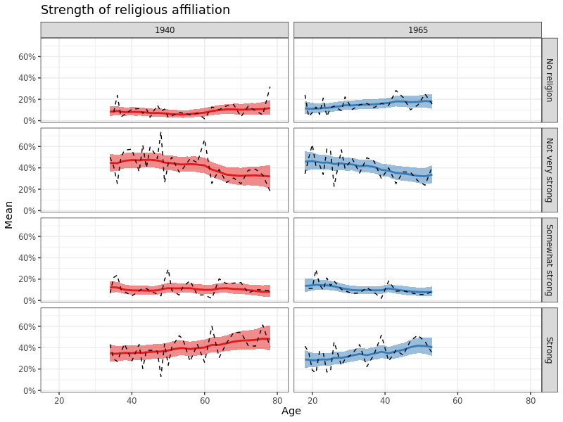

Slide 10
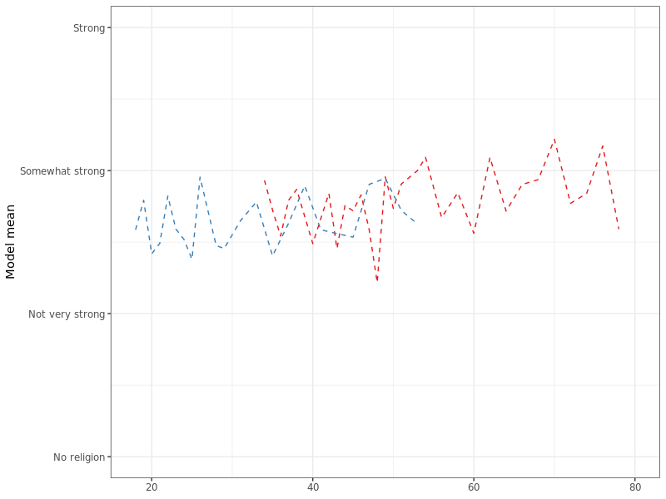
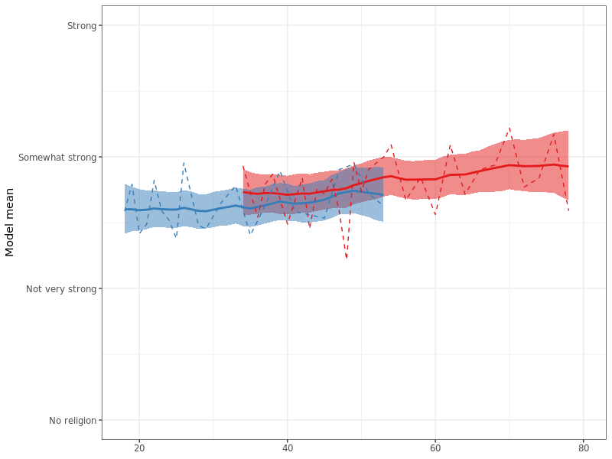

Slide 11
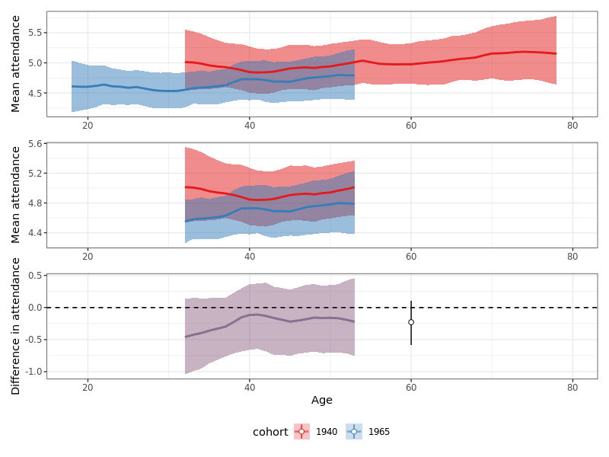

Slide 12
Data
General Social Survey
Frequency of religious service attendance, 1972-2018
Frequency of prayer, 1983-2018
Strength of religious affiliation, 1974-2018
Beliefs about God, 1988-2018
Beliefs about the Bible, 1984-2018

Slide 13
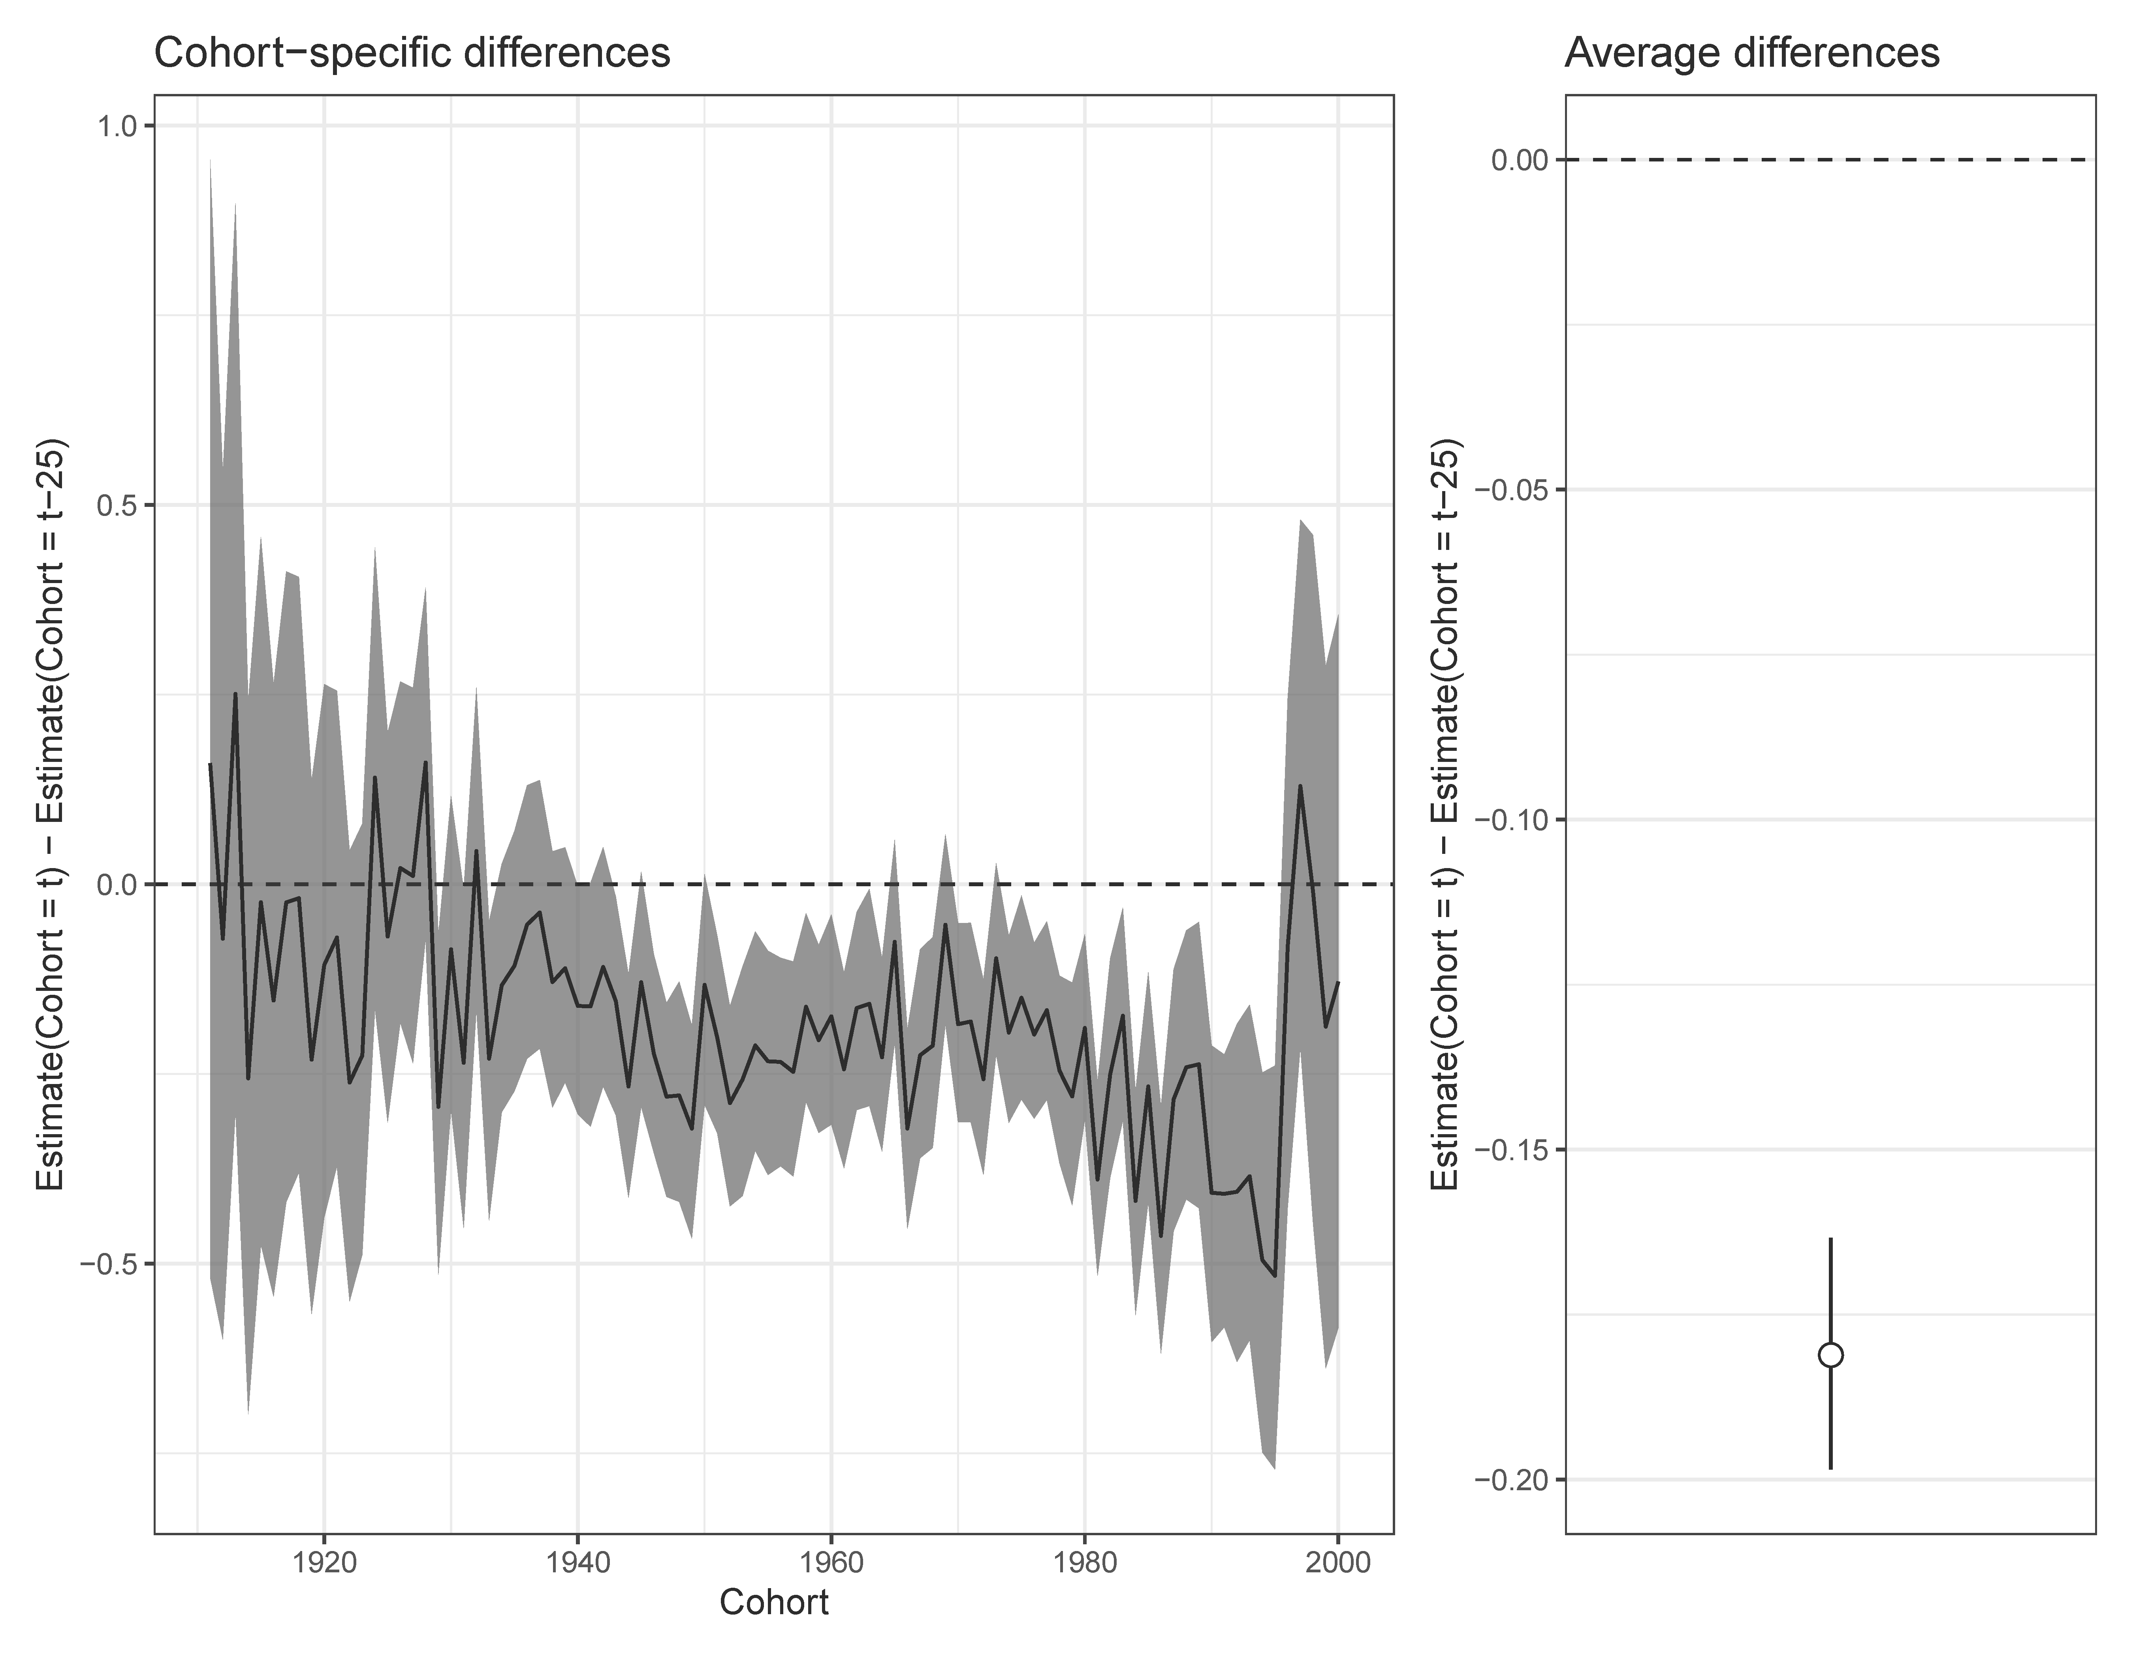
Strength of affiliation (overall)
Nearly all point estimates are less than zero (Younger cohort report weaker affiliation)
The average cohort is 0.18 points lower on the strength scale than the cohort 25 years older.
The 1960 cohort is about 0.2 points lower on the strength of affiliation scale than the 1935 cohort

Slide 14
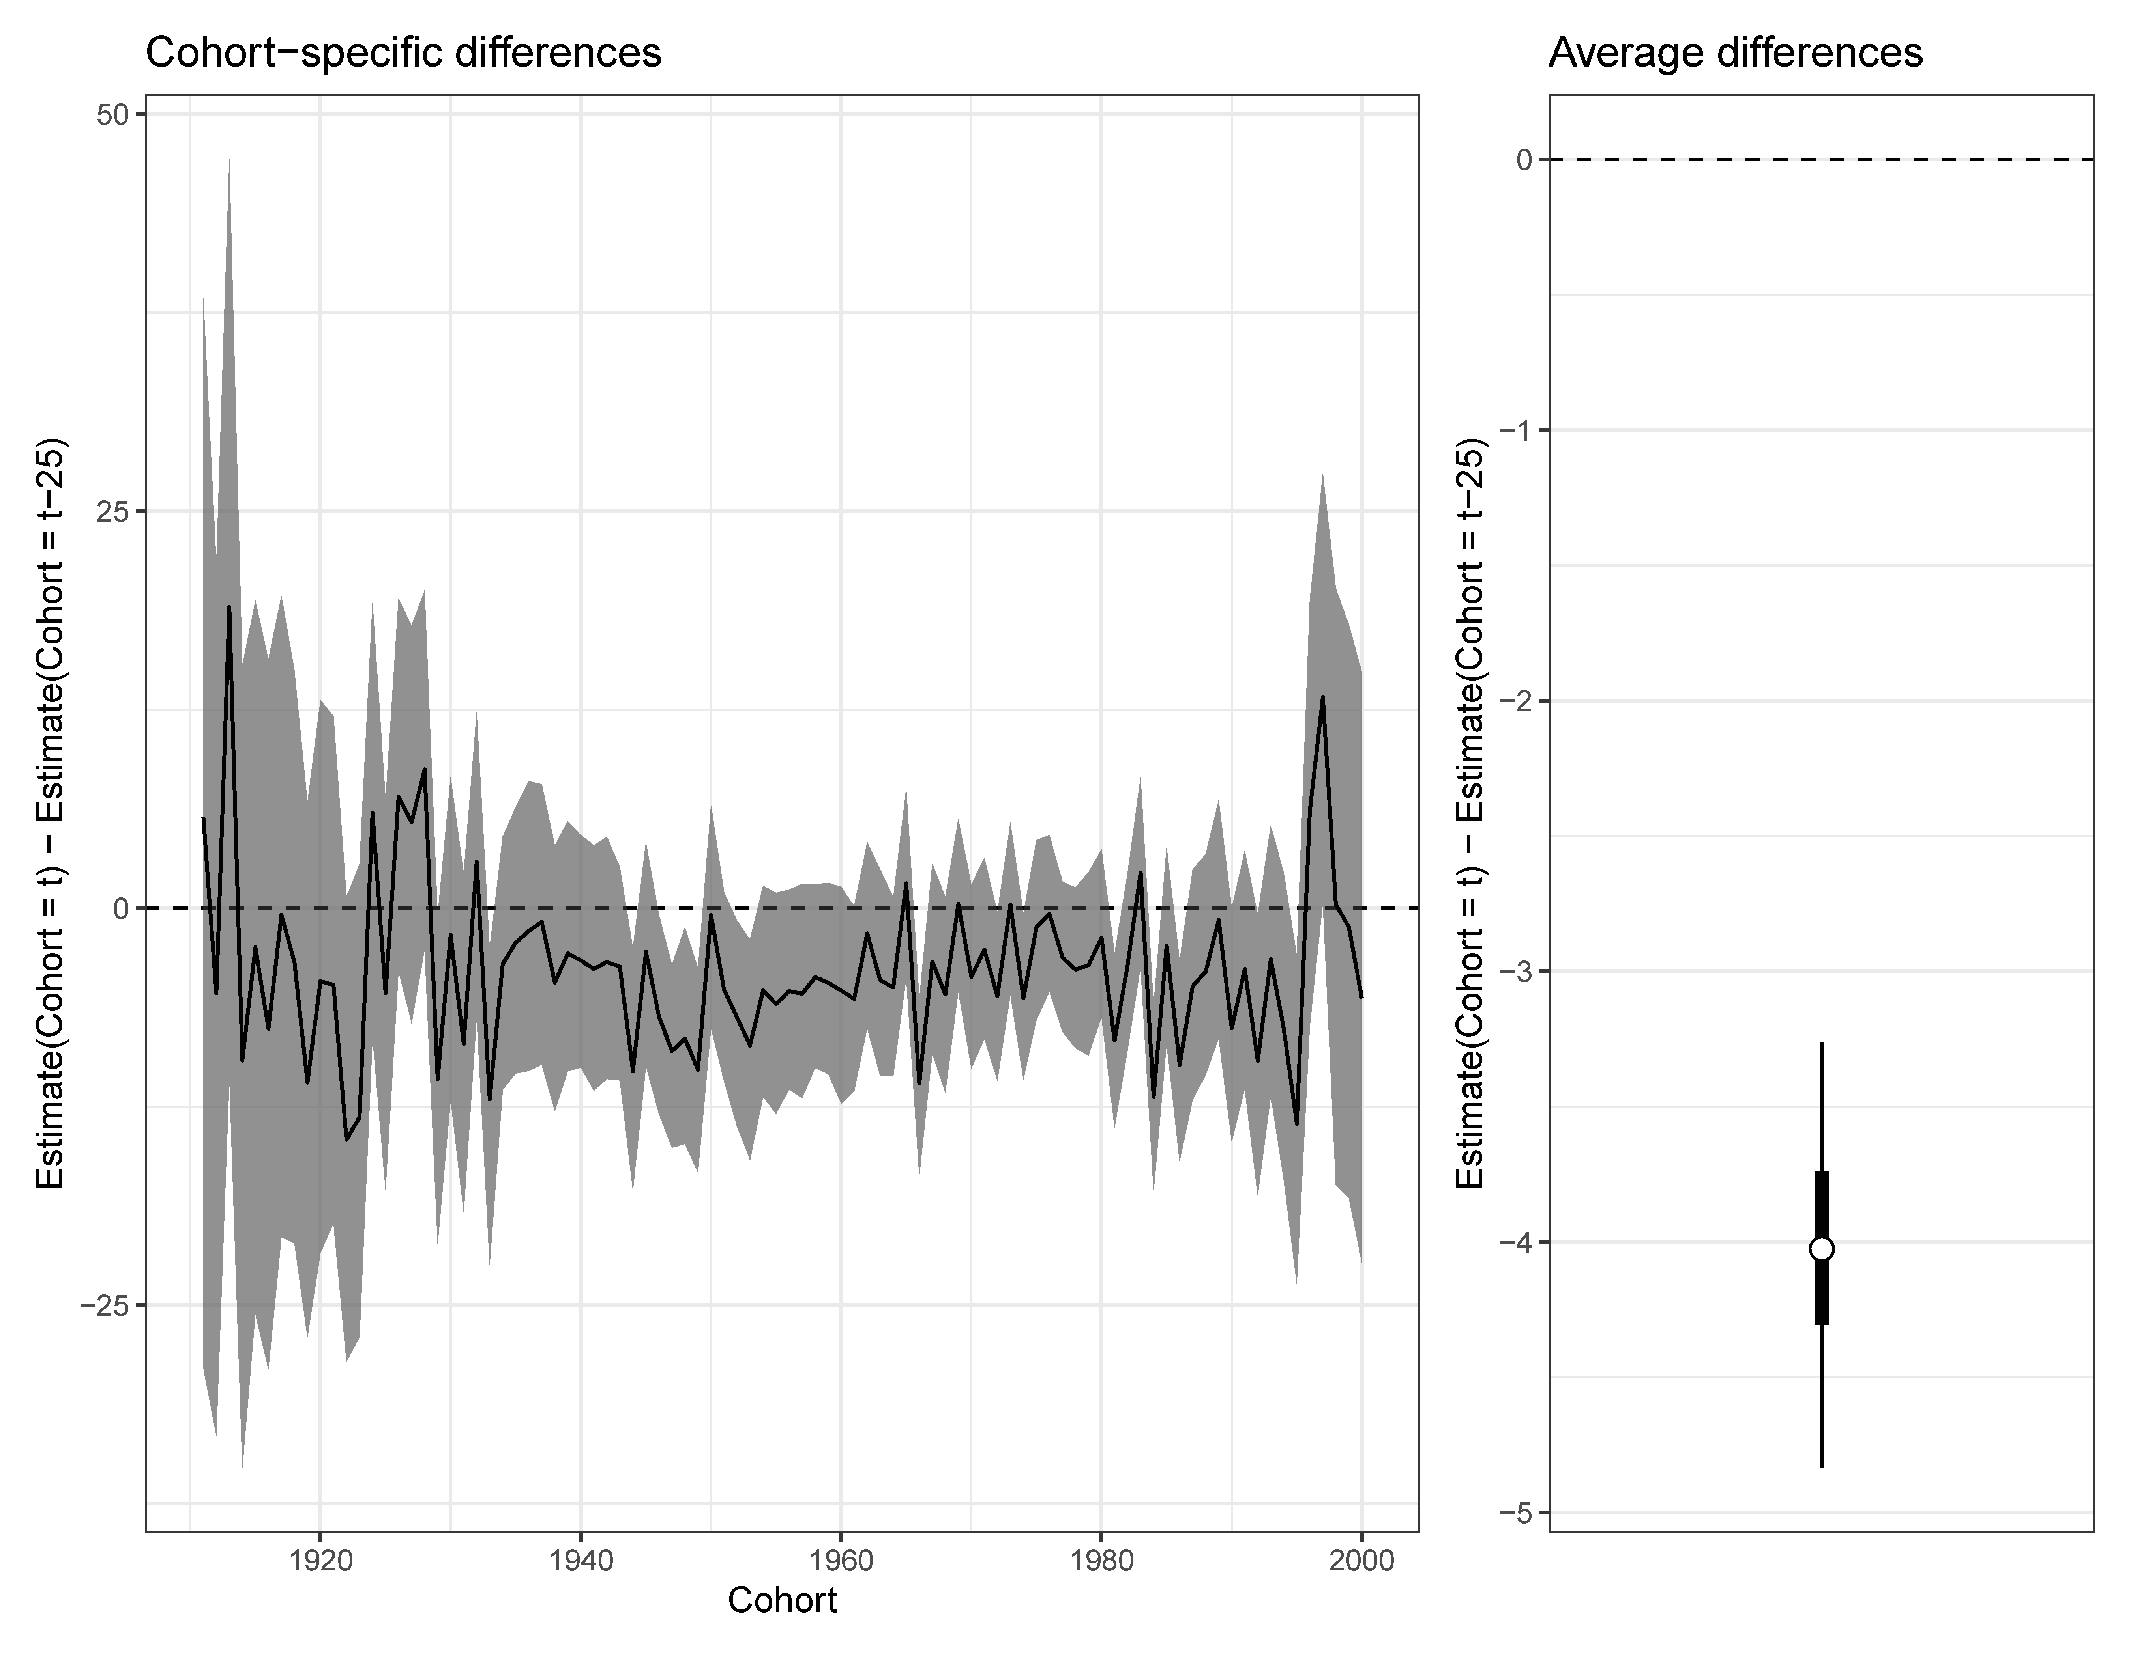
Strength of affiliation (Strong)

Slide 15
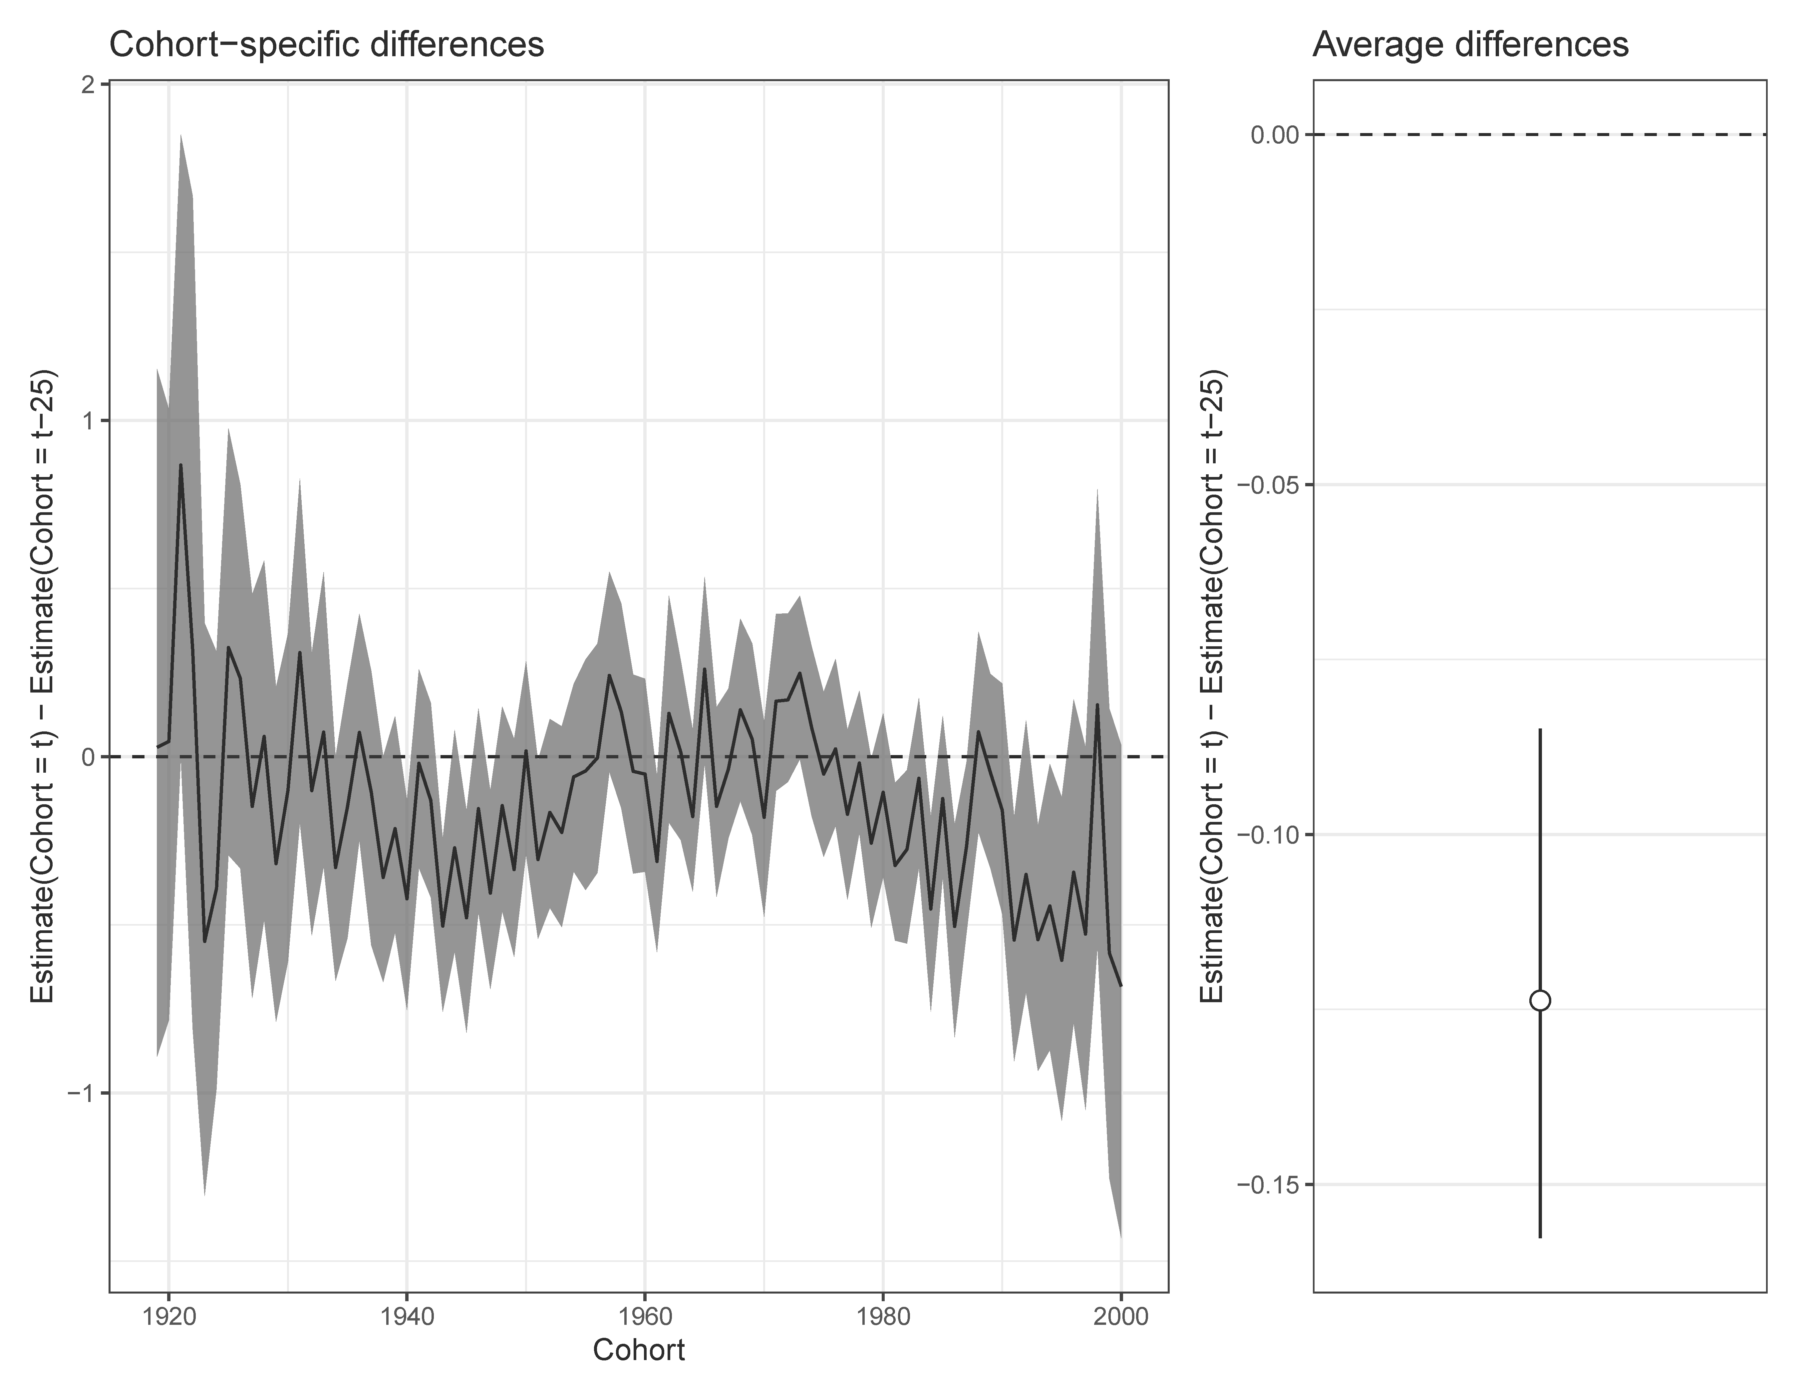
Prayer (overall)
1955-1975 cohorts pray just as frequently as 1930-1950 cohorts
All other cohorts pray less frequently than cohorts born 25 years prior

Slide 16
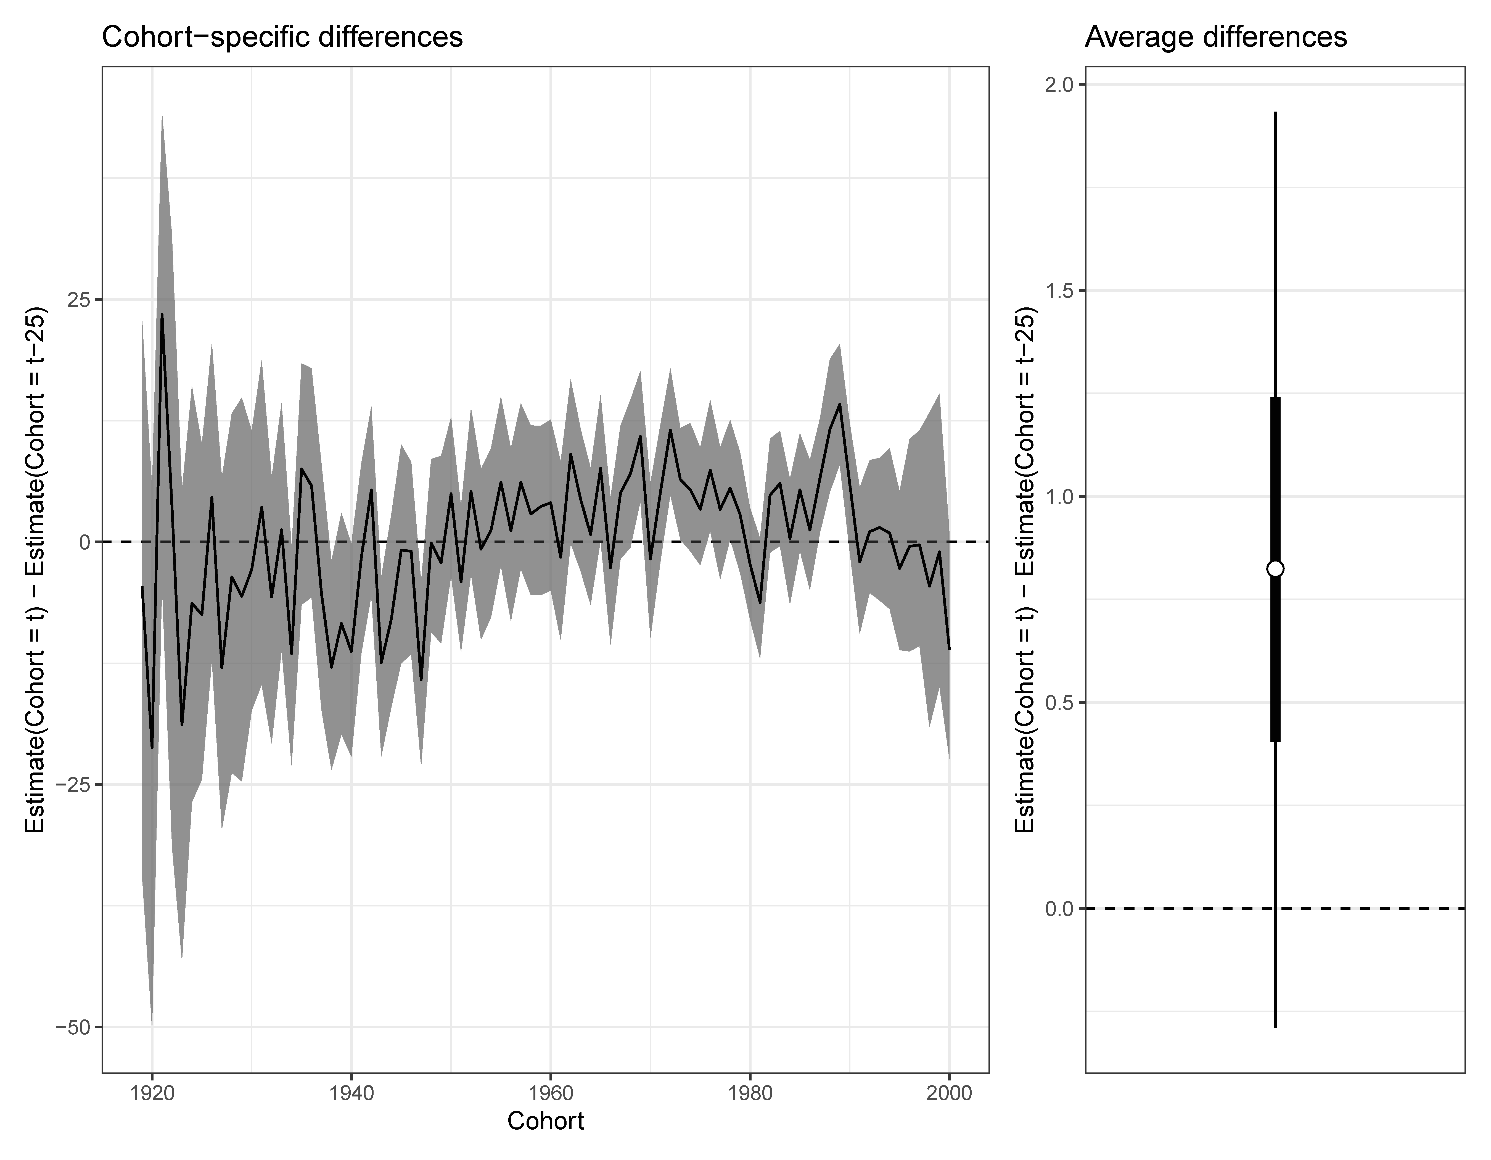
Prayer (Several times a day)
Cohorts 1950+ are more likely than cohorts born 25 years prior to pray several times a day.

Slide 17
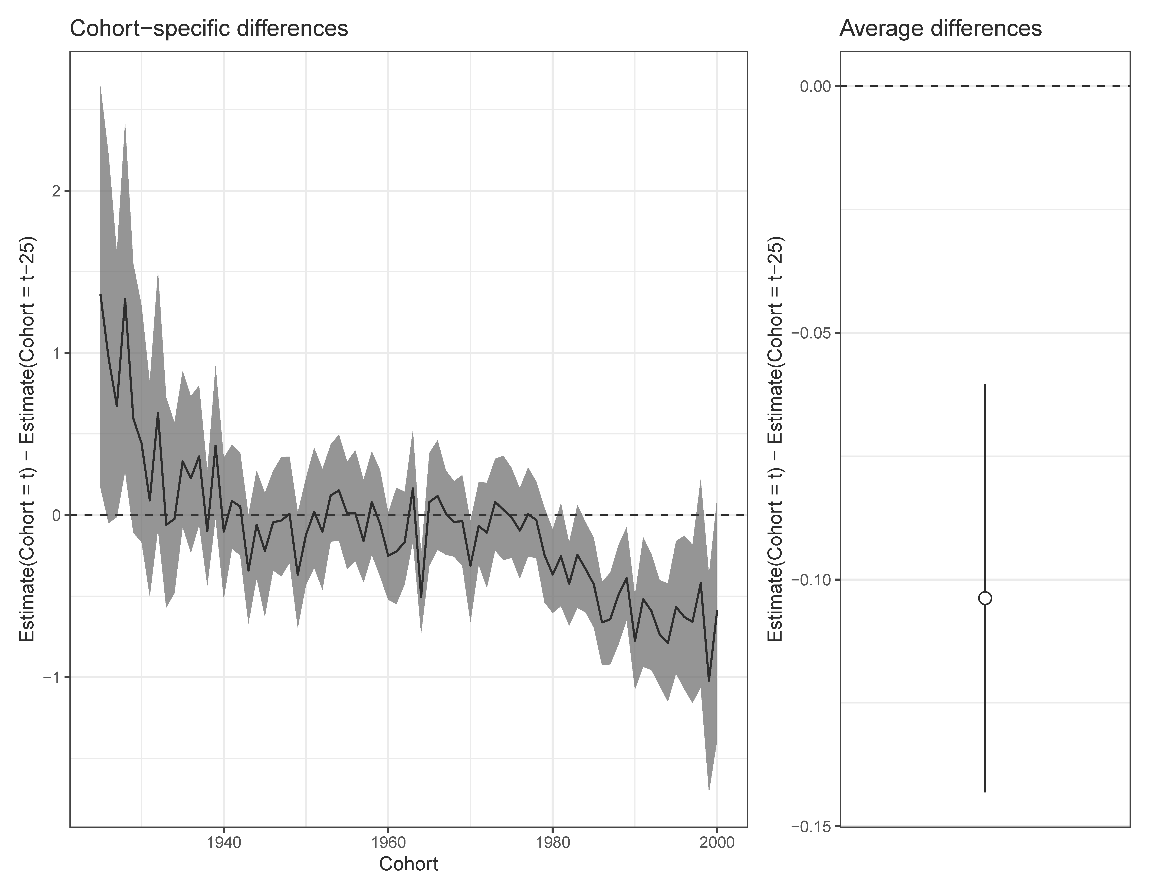
Beliefs about God (overall)
Cohorts 1976+ are much lower than cohorts born 25 years earlier
Cohorts 1940-1975 are slightly lower than cohorts born 25 years earlier

Slide 18
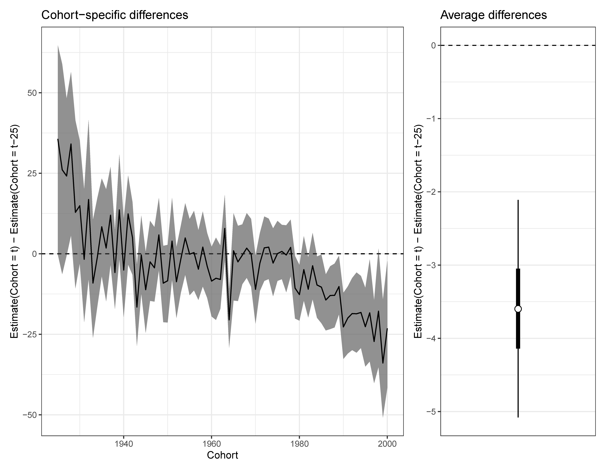
Beliefs about God (Know God exists)

Slide 19
Different patterns, but mostly decline
Pattern 1: Consistent decline (Strength of affiliation)
Pattern 2: Decline overall but growth at the highest level (Prayer)
Pattern 3: Increasingly rapid decline (Beliefs about God)

Slide 20
Thoughts, questions, and next steps
Question: Why does prayer (and particularly >daily prayer) stand out as increasing across cohorts?
Question: Would we see the same patterns within different demographic groups?

Slide 21
sgbrauer@umich.edu
www.simonbrauer.us

Slide 22
References
Brauer, S. G. (2018). The Surprising Predictable Decline of Religion in the United States. Journal for the Scientific Study of Religion, 57(4), 654–675. https://doi.org/10.1111/jssr.12551
Fosse, E., & Winship, C. (2019). Analyzing Age-Period-Cohort Data : A Review and Critique.
Hout, M., & Fischer, C. (2014). Explaining Why More Americans Have No Religious Preference: Political Backlash and Generational Succession, 1987-2012. Sociological Science, 1, 423–447.
Molteni, F., & Biolcati, F. (2022). Religious Decline as a Population Dynamic: Generational Replacement and Religious Attendance in Europe. Social Forces, 1–25. https://doi.org/10.1093/sf/soac099
Molteni, F., & Biolcati, F. (2018). Shifts in religiosity across cohorts in Europe: A multilevel and multidimensional analysis based on the European Values Study. Social Compass, 65(3), 413–432. https://doi.org/10.1177/0037768618772969
Puga-Gonzalez, I., Voas, D., Kiszkiel, L., Bacon, R. J., Wildman, W. J., Talmont-Kaminski, K., & Shults, F. L. (2022). Modeling Fuzzy Fidelity: Using Microsimulation to Explore Age, Period, and Cohort Effects in Secularization. Journal of Religion and Demography, 9(1–2), 111–137. https://doi.org/10.1163/2589742x-bja10012
Schnabel, L., & Bock, S. (2018). The continuing persistence of intense religion in the United States. Sociological Science, 5, 711–721. https://doi.org/10.15195/V5.A30
Schwadel, P. (2010). Age, Period, and Cohort Effects on US Religious Service Attendance: The Declining Impact of Sex, Southern Residence, and Catholic Affiliation. Sociology of Religion, 71(1), 2–24. https://doi.org/10.1093/socrel/srq005
Shulgin, S., Zinkina, J., & Korotayev, A. (2019). Religiosity and Aging: Age and Cohort Effects and Their Implications for the Future of Religious Values in High-Income OECD Countries. Journal for the Scientific Study of Religion, 58, 591–603. https://doi.org/10.1111/jssr.12613
Voas, D., & Chaves, M. (2016). Is the United States a Counterexample to the Secularization Thesis? American Journal of Sociology, 121(5), 1517–1556.
Voas, D., & Storm, I. (2021). National Context, Parental Socialization, and the Varying Relationship Between Religious Belief and Practice. Journal for the Scientific Study of Religion, 60(1), 189–197. https://doi.org/10.1111/jssr.12691
Wilkins-Laflamme, S. (2021). A Tale of Decline or Change? Working Toward a Complementary Understanding of Secular Transition and Individual Spiritualization Theories. Journal for the Scientific Study of Religion, 60(3), 516–539. https://doi.org/10.1111/jssr.12721

Slide 23
Approaches to evaluating religious change
Descriptive approaches
Voas and Chaves 2016
Schnabel and Bock 2018

Slide 24
Approaches to evaluating religious change
Descriptive approaches
Voas and Chaves
Schnabel and Bock
Analytic approaches
Molteni and Biolcati 2018, 2022
Voas and Storm 2021
Wilkins-Laflamme 2021
Shulgin, Zinkina, and Korotayev 2019
Schwadel 2010
Hout and Fischer 2014
Brauer 2018

Slide 25
Approaches to evaluating religious change
Simulation approaches
Puga-Gonzales et. al. 2022
Session D-1 (Talmont-Kaminski, Burger)
Descriptive approaches
Voas and Chaves
Schnabel and Bock
Analytic approaches
Molteni and Biolcati 2018, 2022
Voas and Storm 2021
Wilkins-Laflamme 2021
Shulgin, Zinkina, and Korotayev 2019
Schwadel 2010
Hout and Fischer 2014
Brauer 2018

Slide 26
Data Summary
 | Cohort |  |  | Age |  |  | Year
 | Min | Max | # | Min | Max | # | Min | Max | #
Frequency of attendance | 1883 | 2000 | 118 | 18 | 89 | 72 | 1972 | 2018 | 32
Frequency of prayer | 1894 | 2000 | 107 | 18 | 89 | 72 | 1983 | 2018 | 21
Strength of affiliation | 1885 | 2000 | 116 | 18 | 89 | 72 | 1974 | 2018 | 30
Beliefs about the Bible | 1895 | 2000 | 106 | 18 | 89 | 72 | 1984 | 2018 | 21
Beliefs about God | 1899 | 2000 | 102 | 18 | 89 | 72 | 1988 | 2018 | 13

Slide 27
Model
Bayesian probability model with a multinomial outcome and a spatial structure within cohorts
Estimated with Markov Chain Monte Carlo and sensible priors
Outcome is treated as categorical (i.e. estimates probabilities)
Assumes probabilities from adjacent ages within the same cohort are similar
Random walk (i.e. no assumed structure to the trajectories)
No assumed structure across cohorts; cohorts only share a stepsize (e.g. how much change we should expect to see with one additional year of age)

Slide 28
Target Quantities
Age-specific difference between two cohorts
$${Δ_{c,a}= μ}_{c,a}−μ_{c−25,a}$$
Average of age-specific differences between two cohorts
$$Δ_{c}=\frac{\sum_{a=a_{1}}^{a_{n}}{Δ_{c,a}}}{n}$$
Average of average cohort differences
$$Δ=\frac{\sum_{c=c_{1}}^{c_{n}}{Δ_{c}}}{n}$$

Slide 29
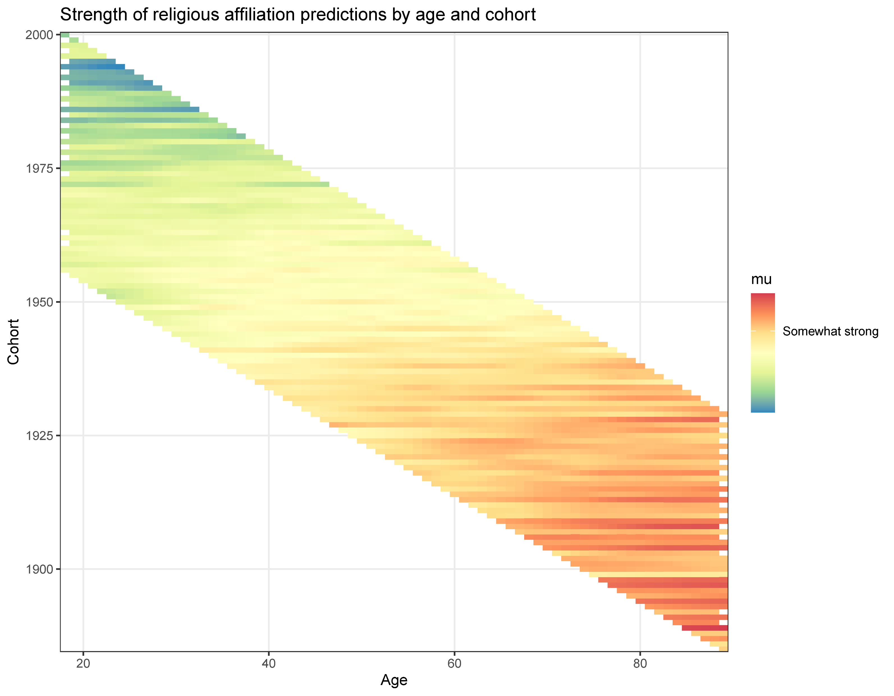
Strength of affiliation (overall)
Same cohort, different ages
Same age, different cohorts

Slide 30
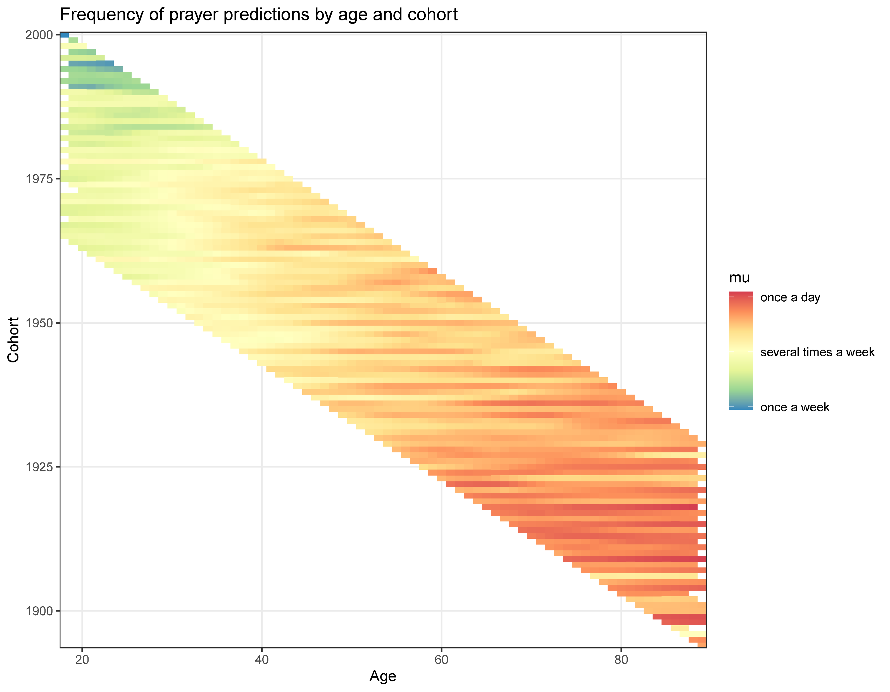
Prayer (overall)

Slide 31
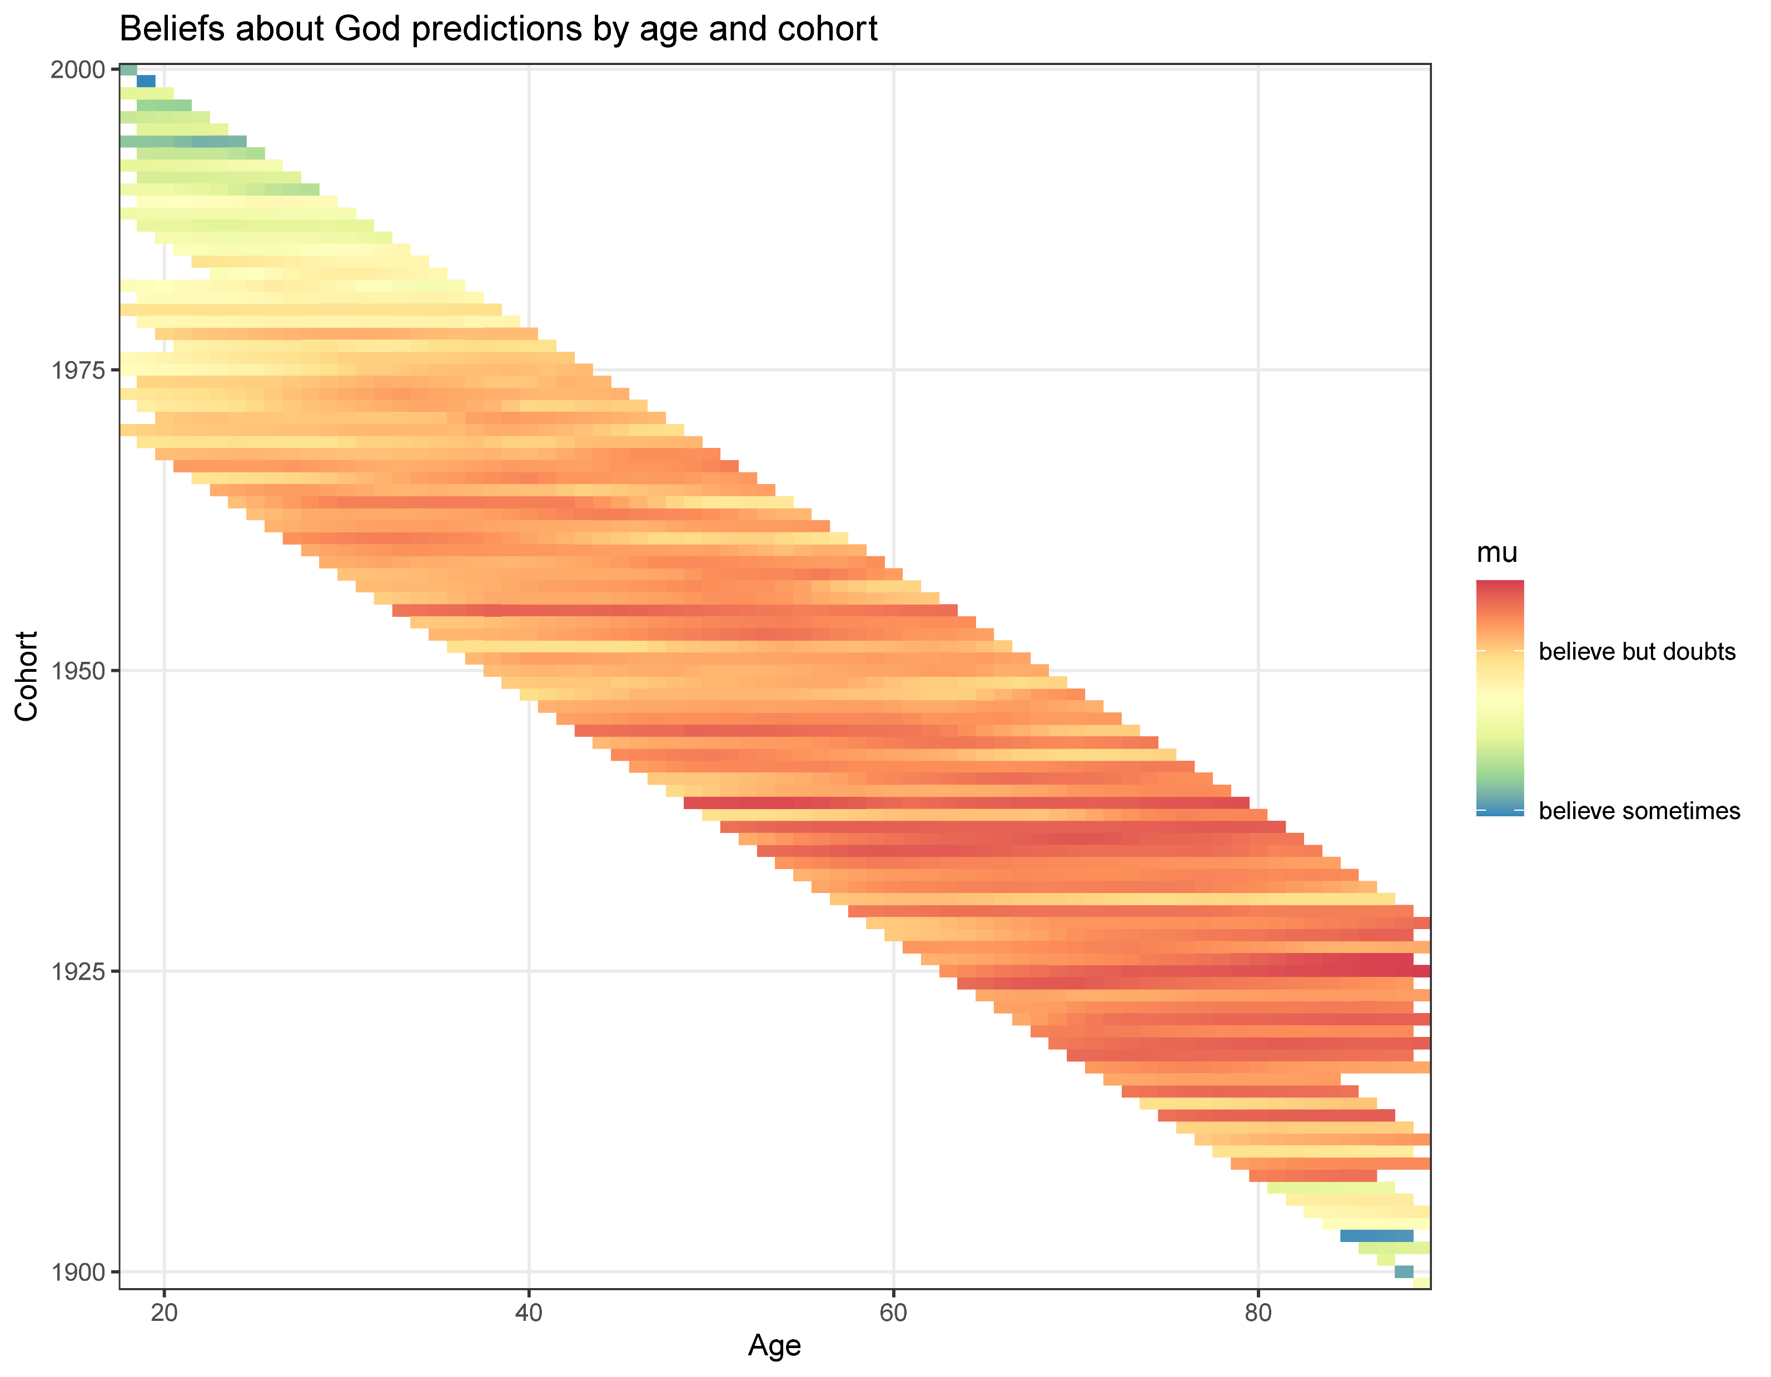
Beliefs about God (overall)

Slide 32
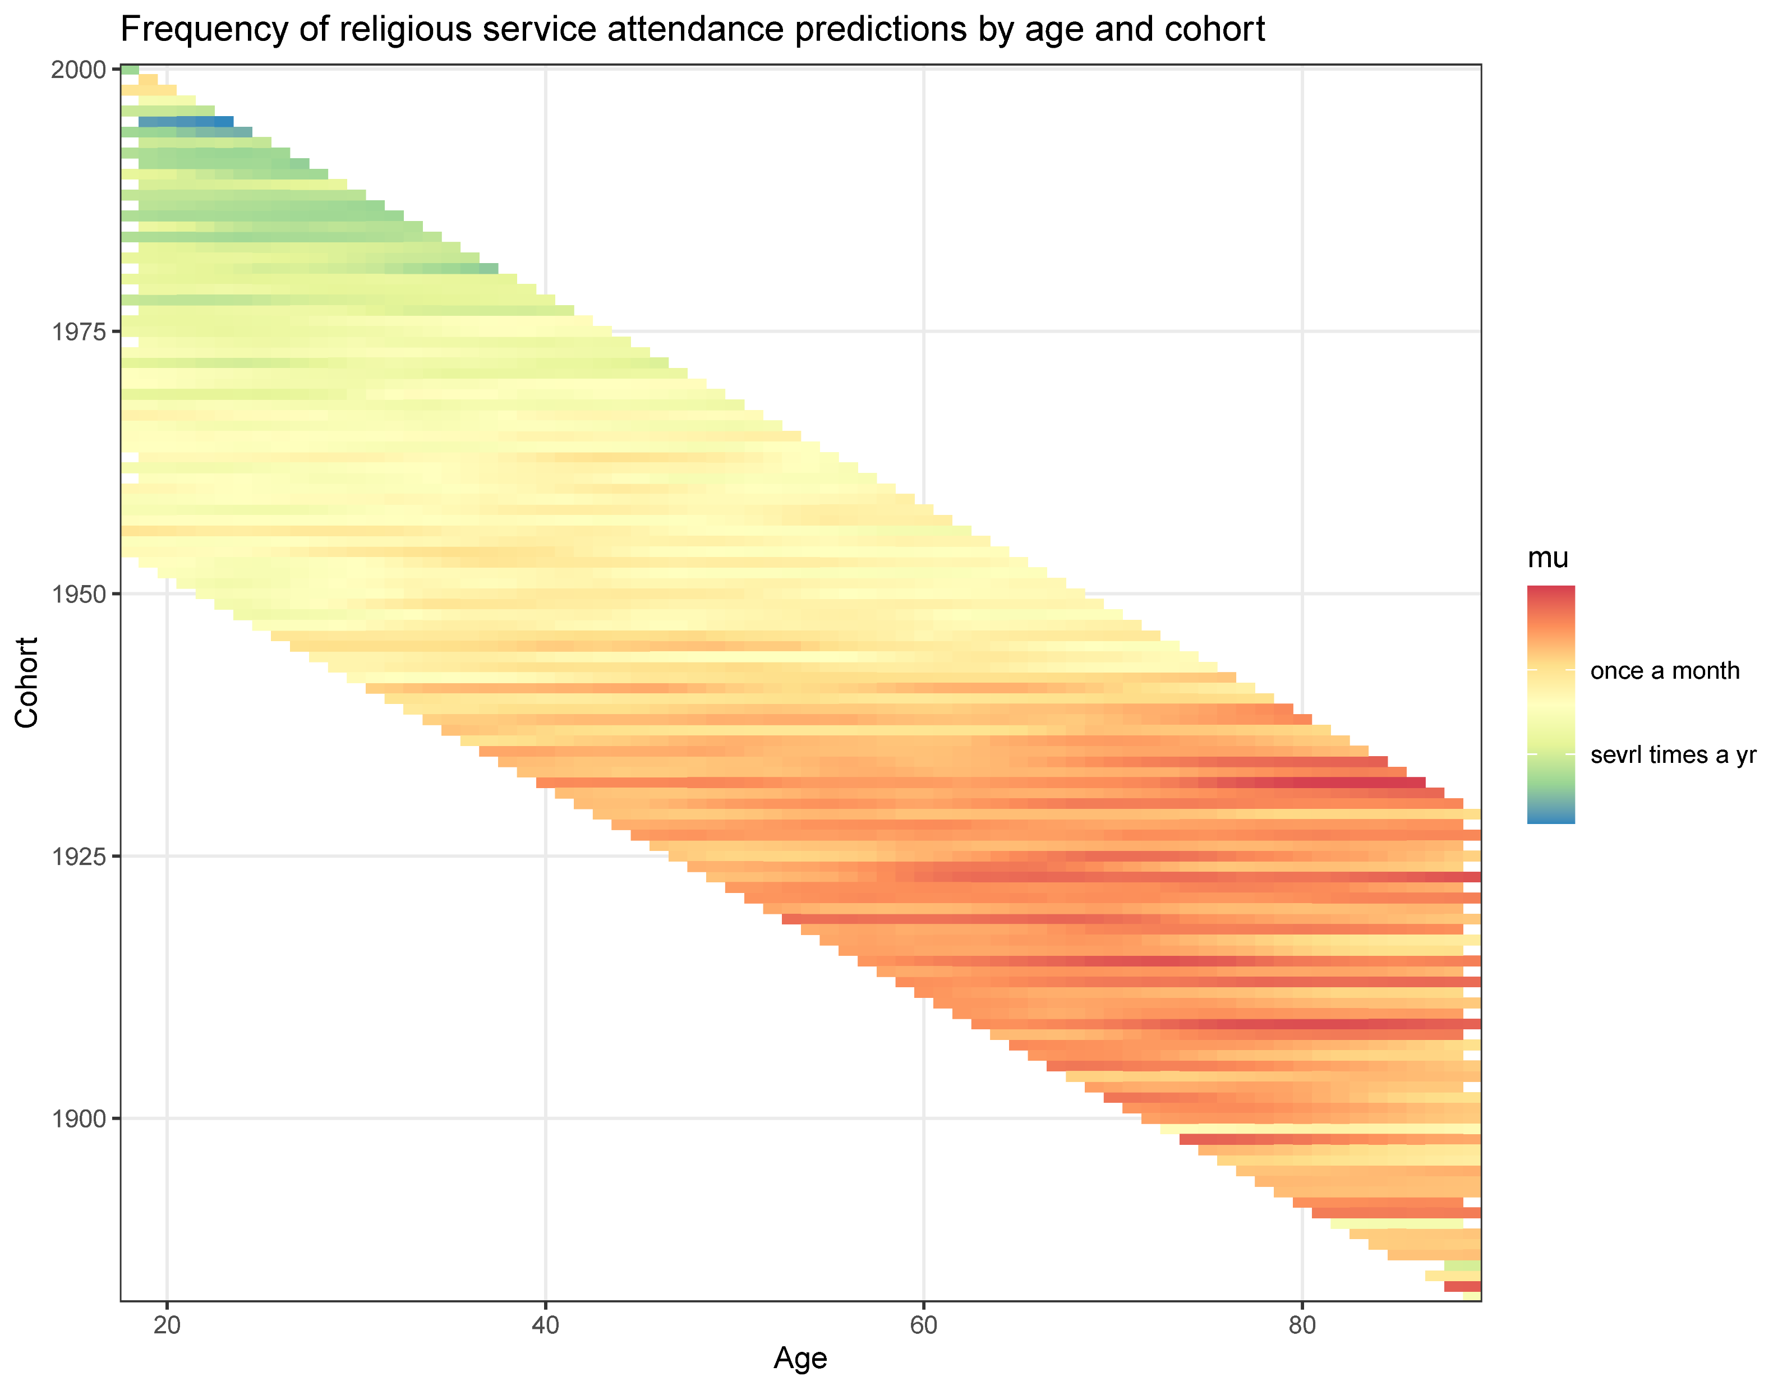
Religious service attendance (overall)

Slide 33
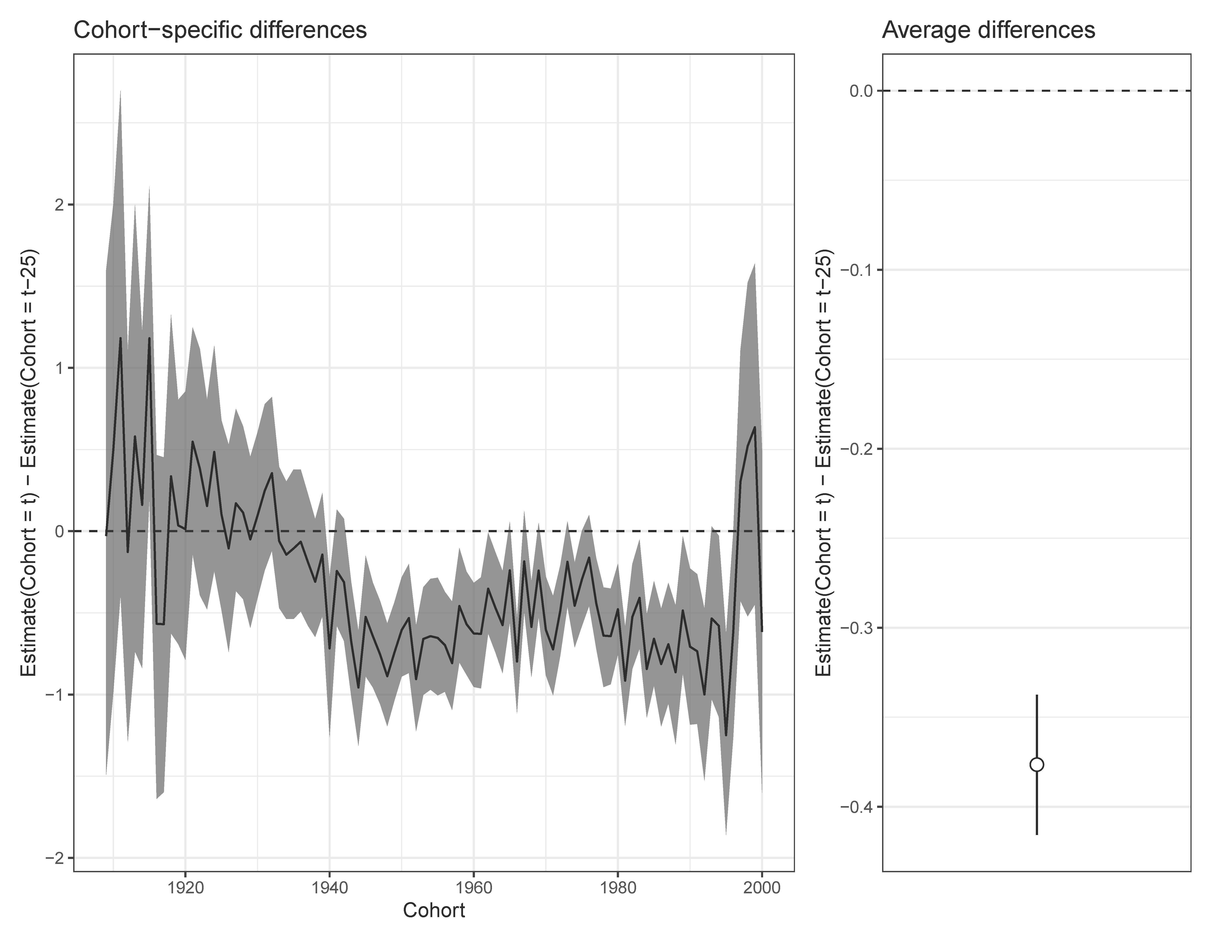
Religious service attendance (overall)

Slide 34
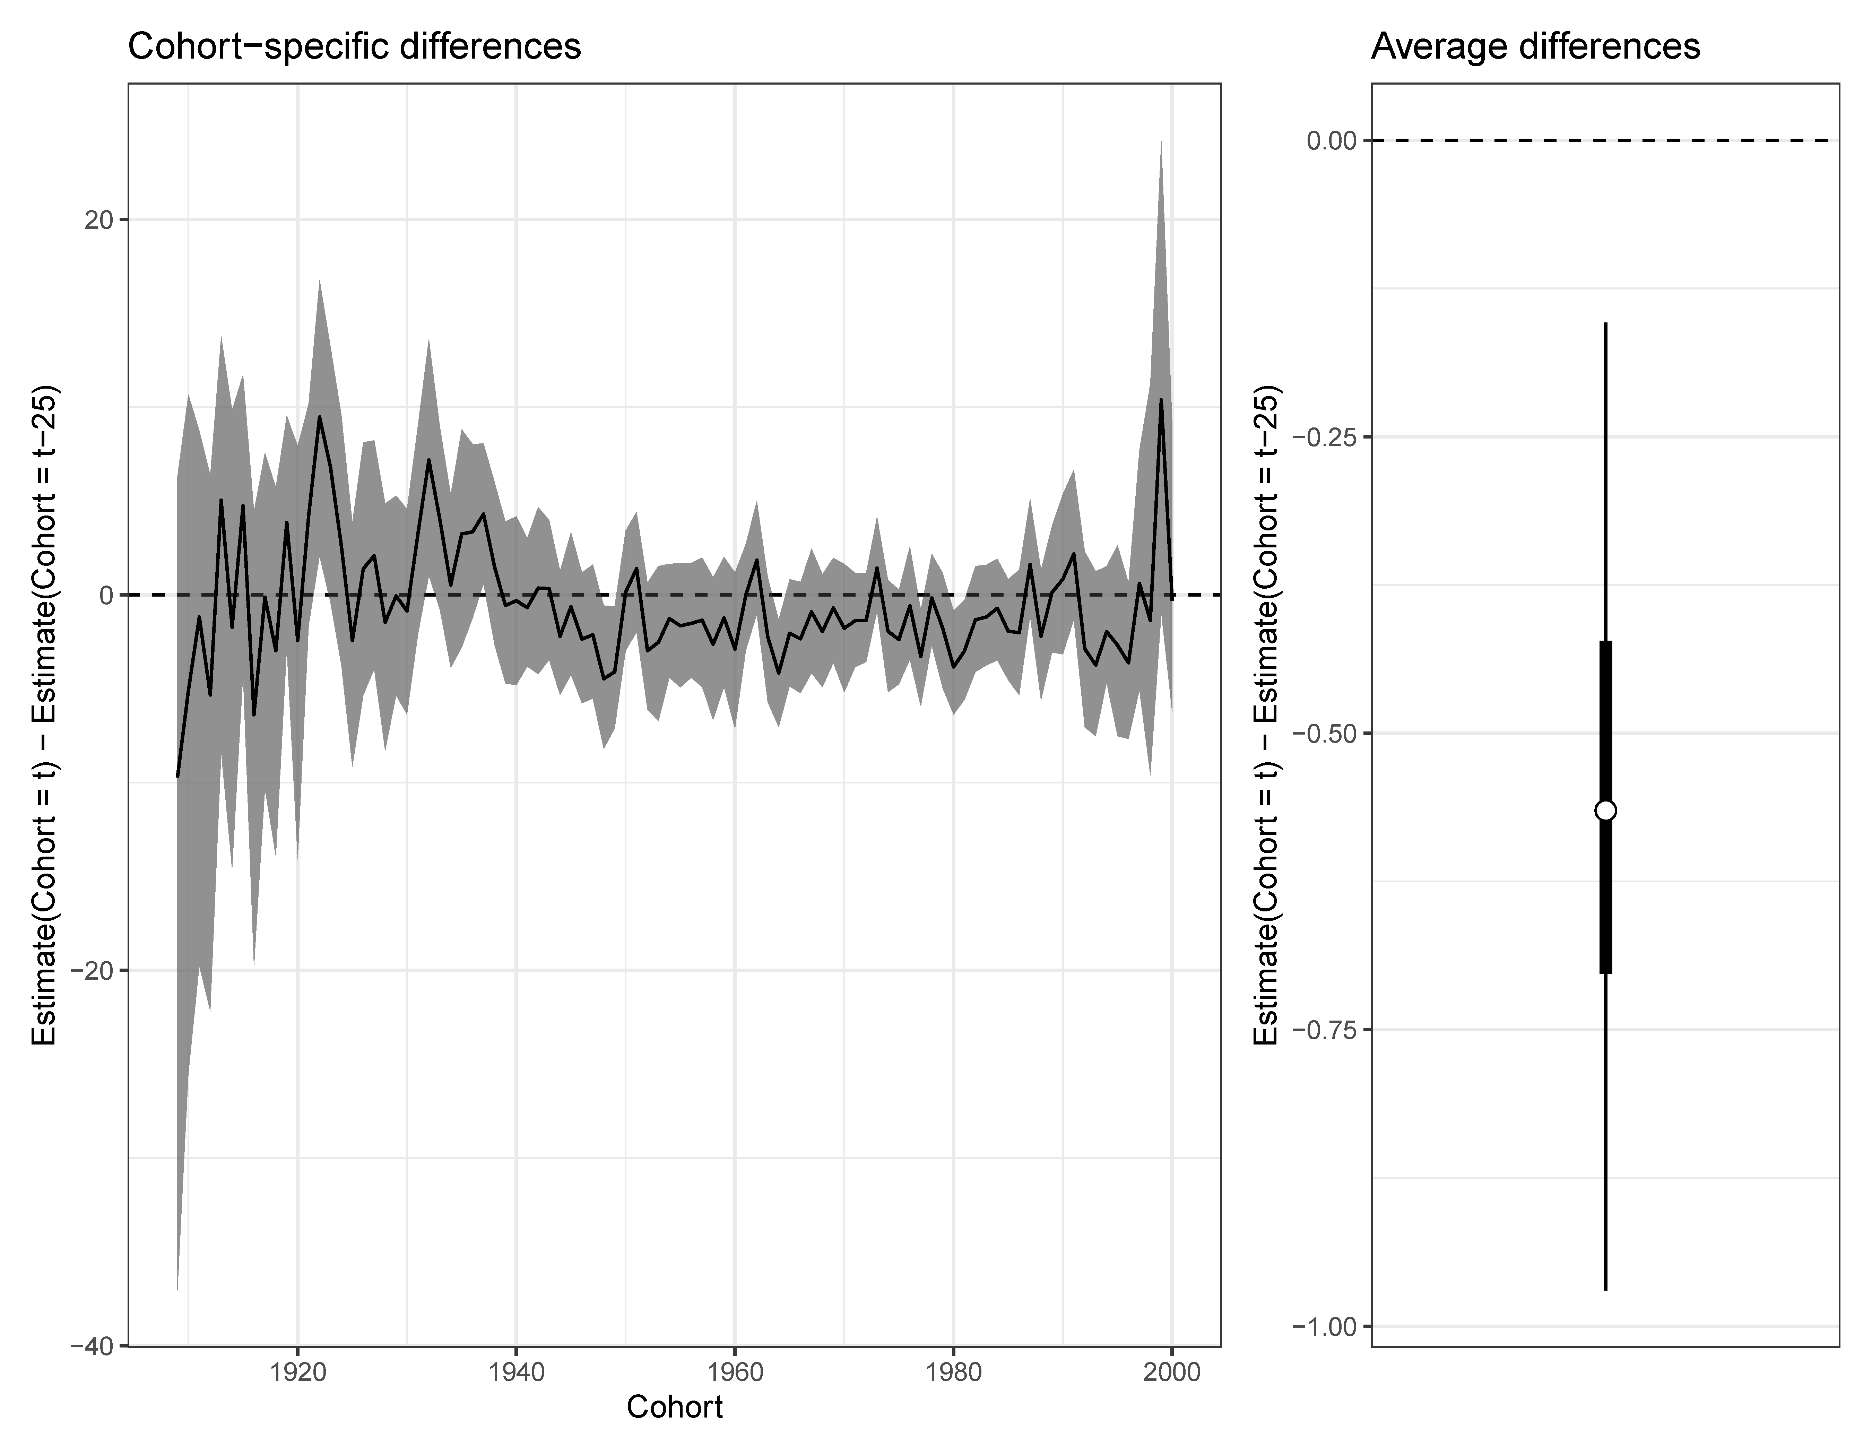
Attends > Weekly

Slide 35
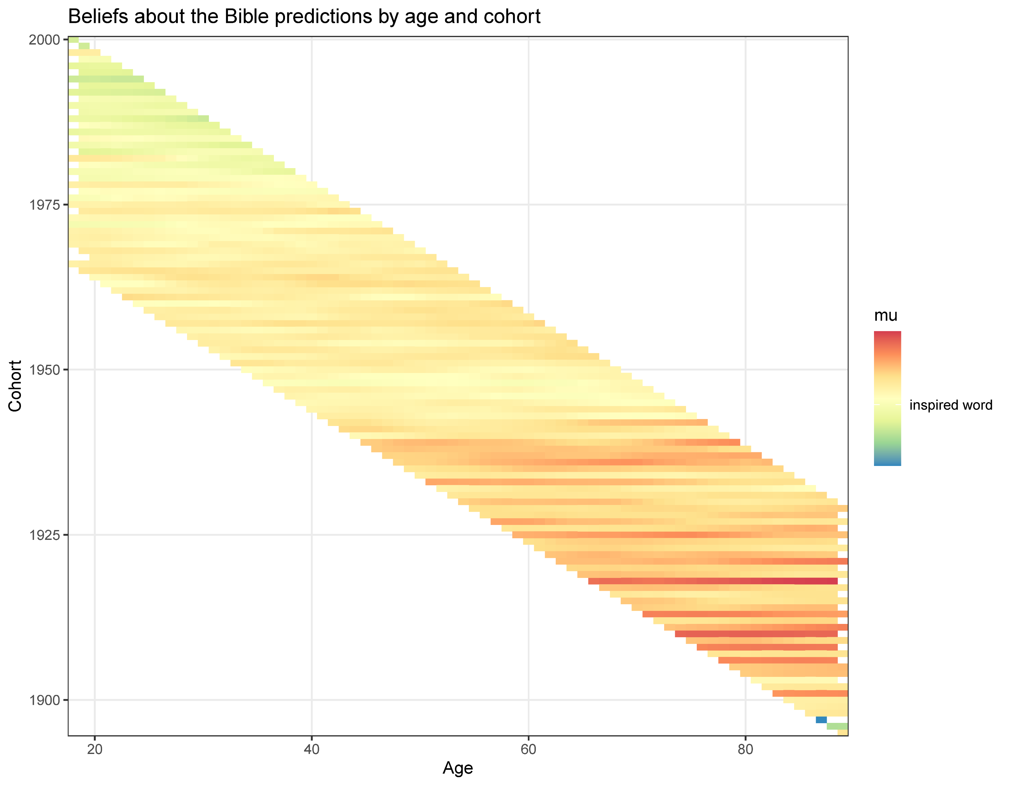
Beliefs about the Bible (overall)

Slide 36
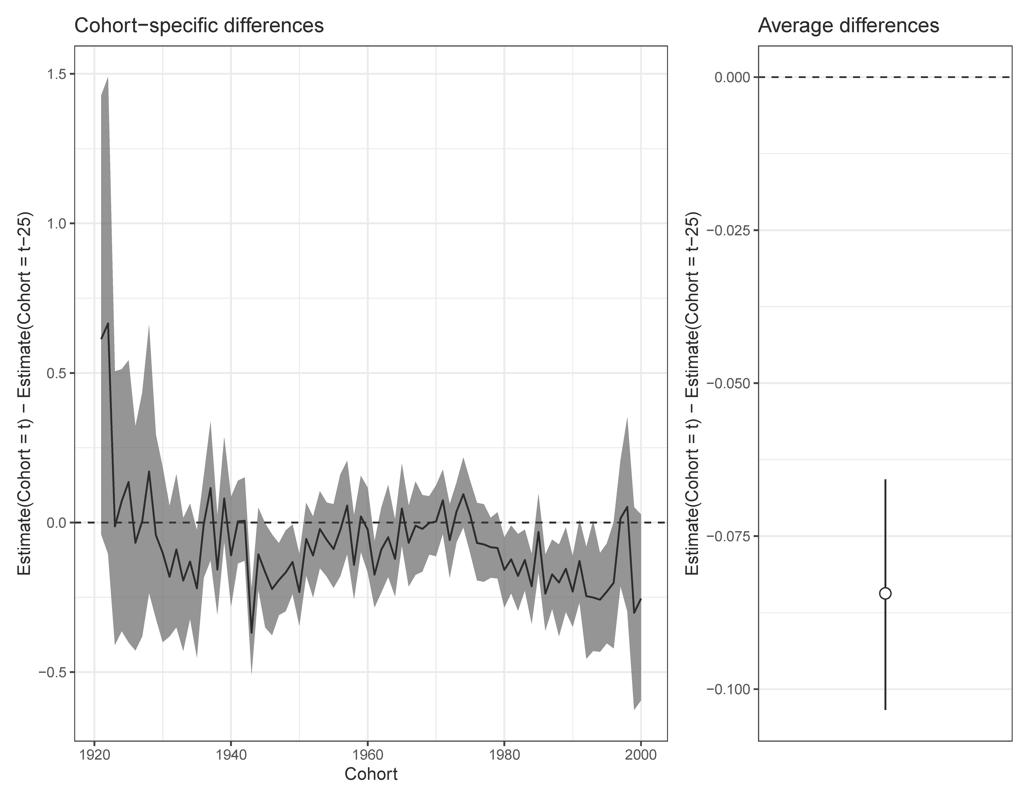
Beliefs about the Bible (overall)

Slide 37
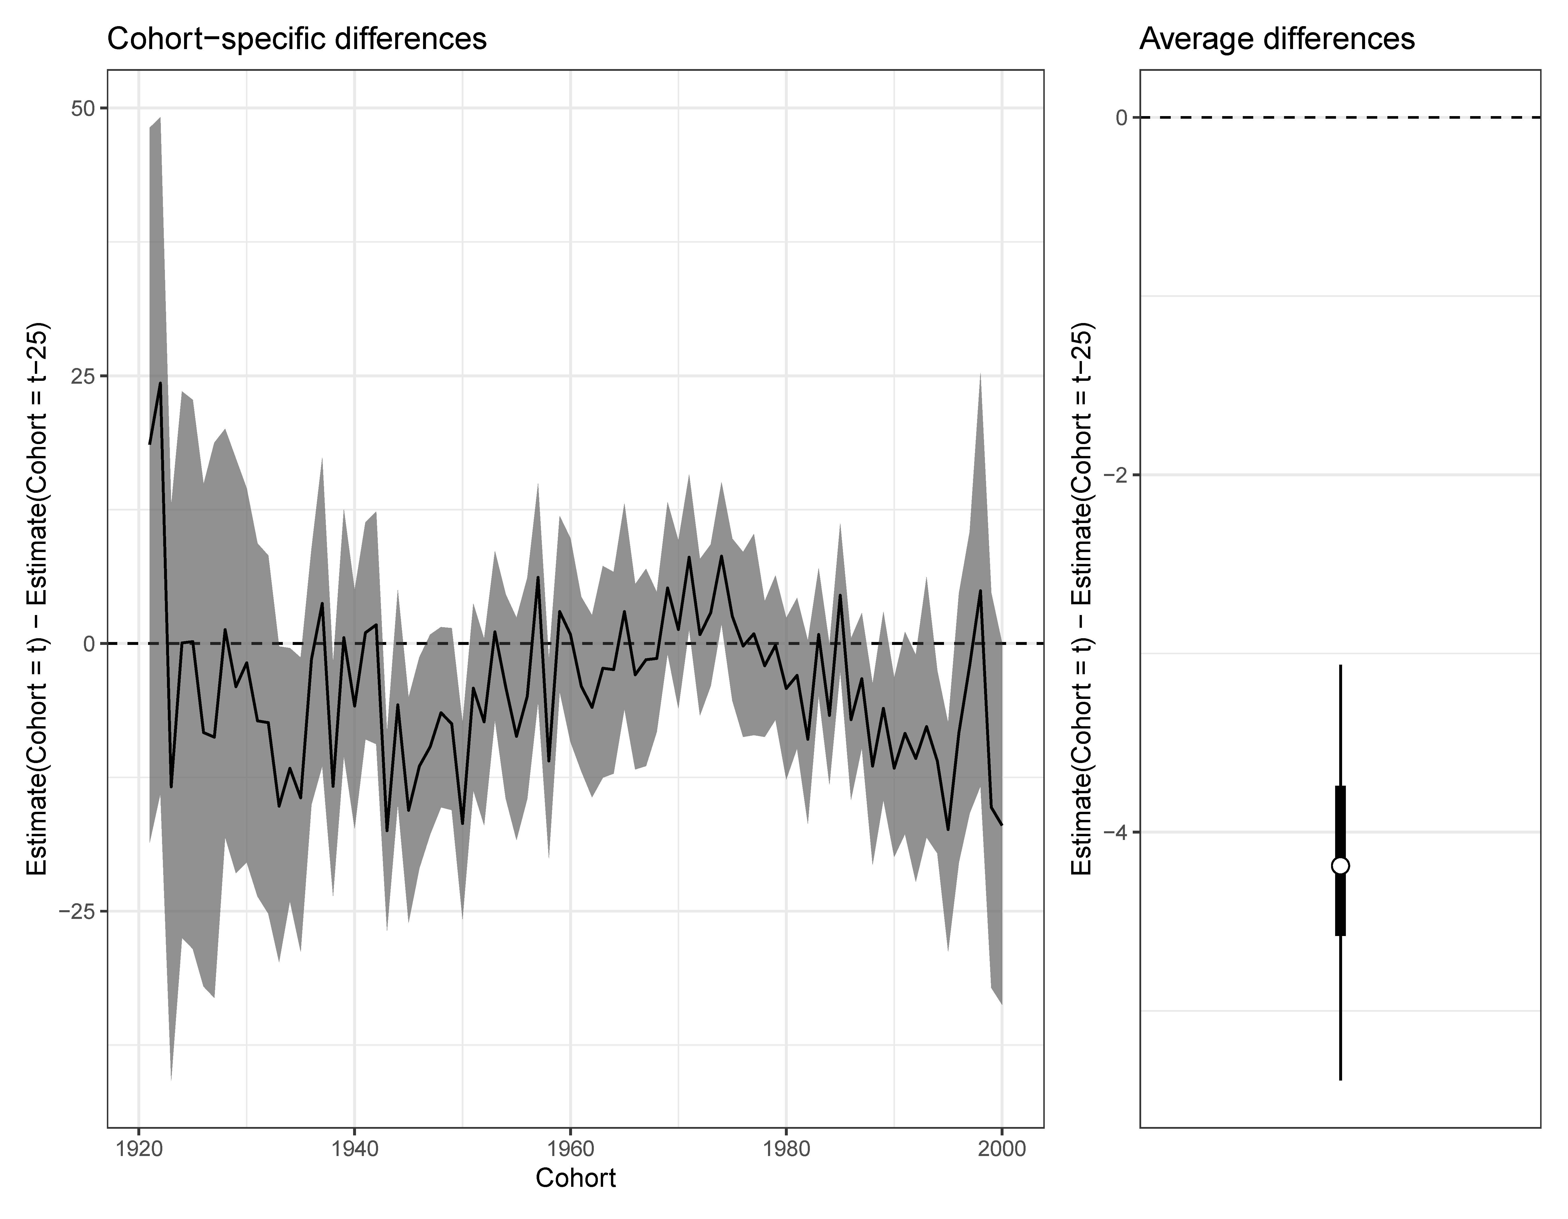
Beliefs about the Bible (Word of God)

Slide 38
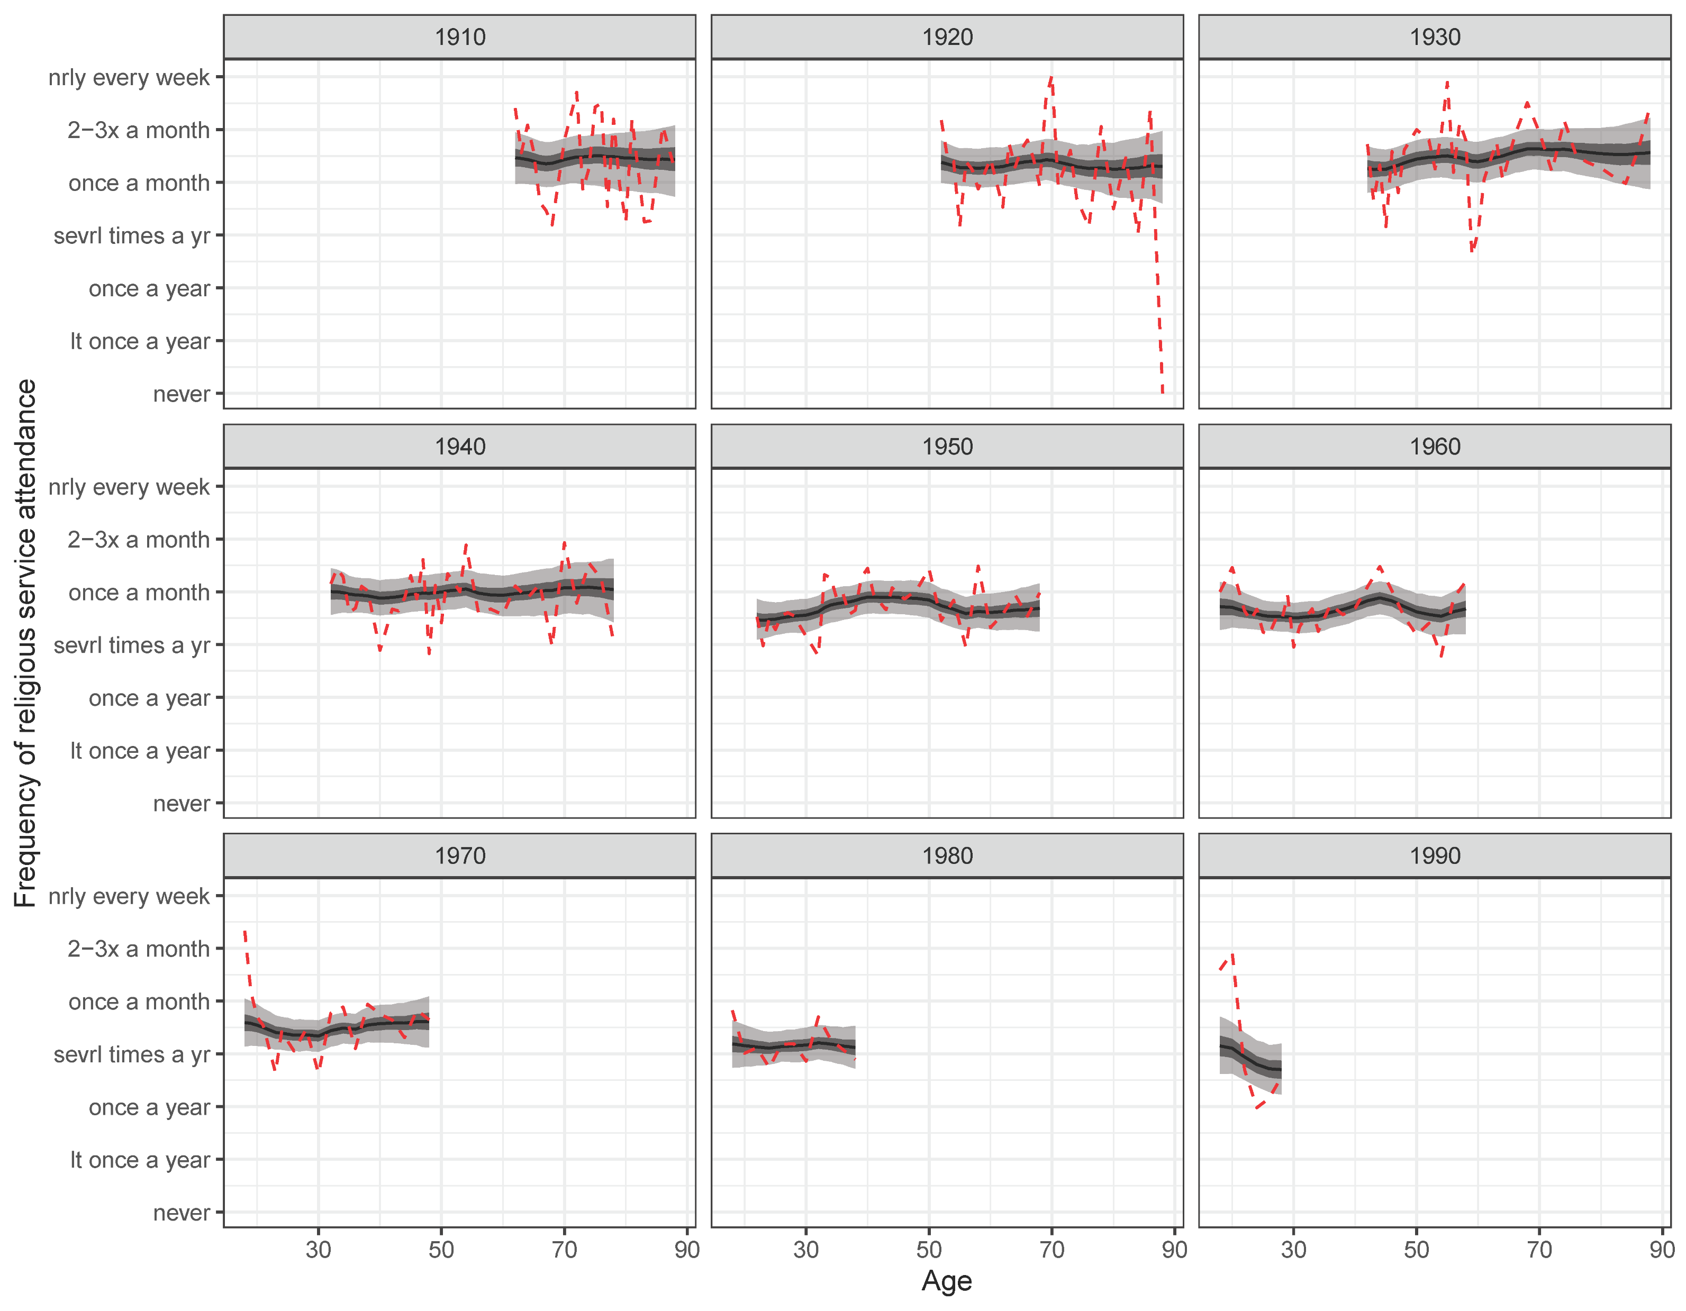

Slide 39
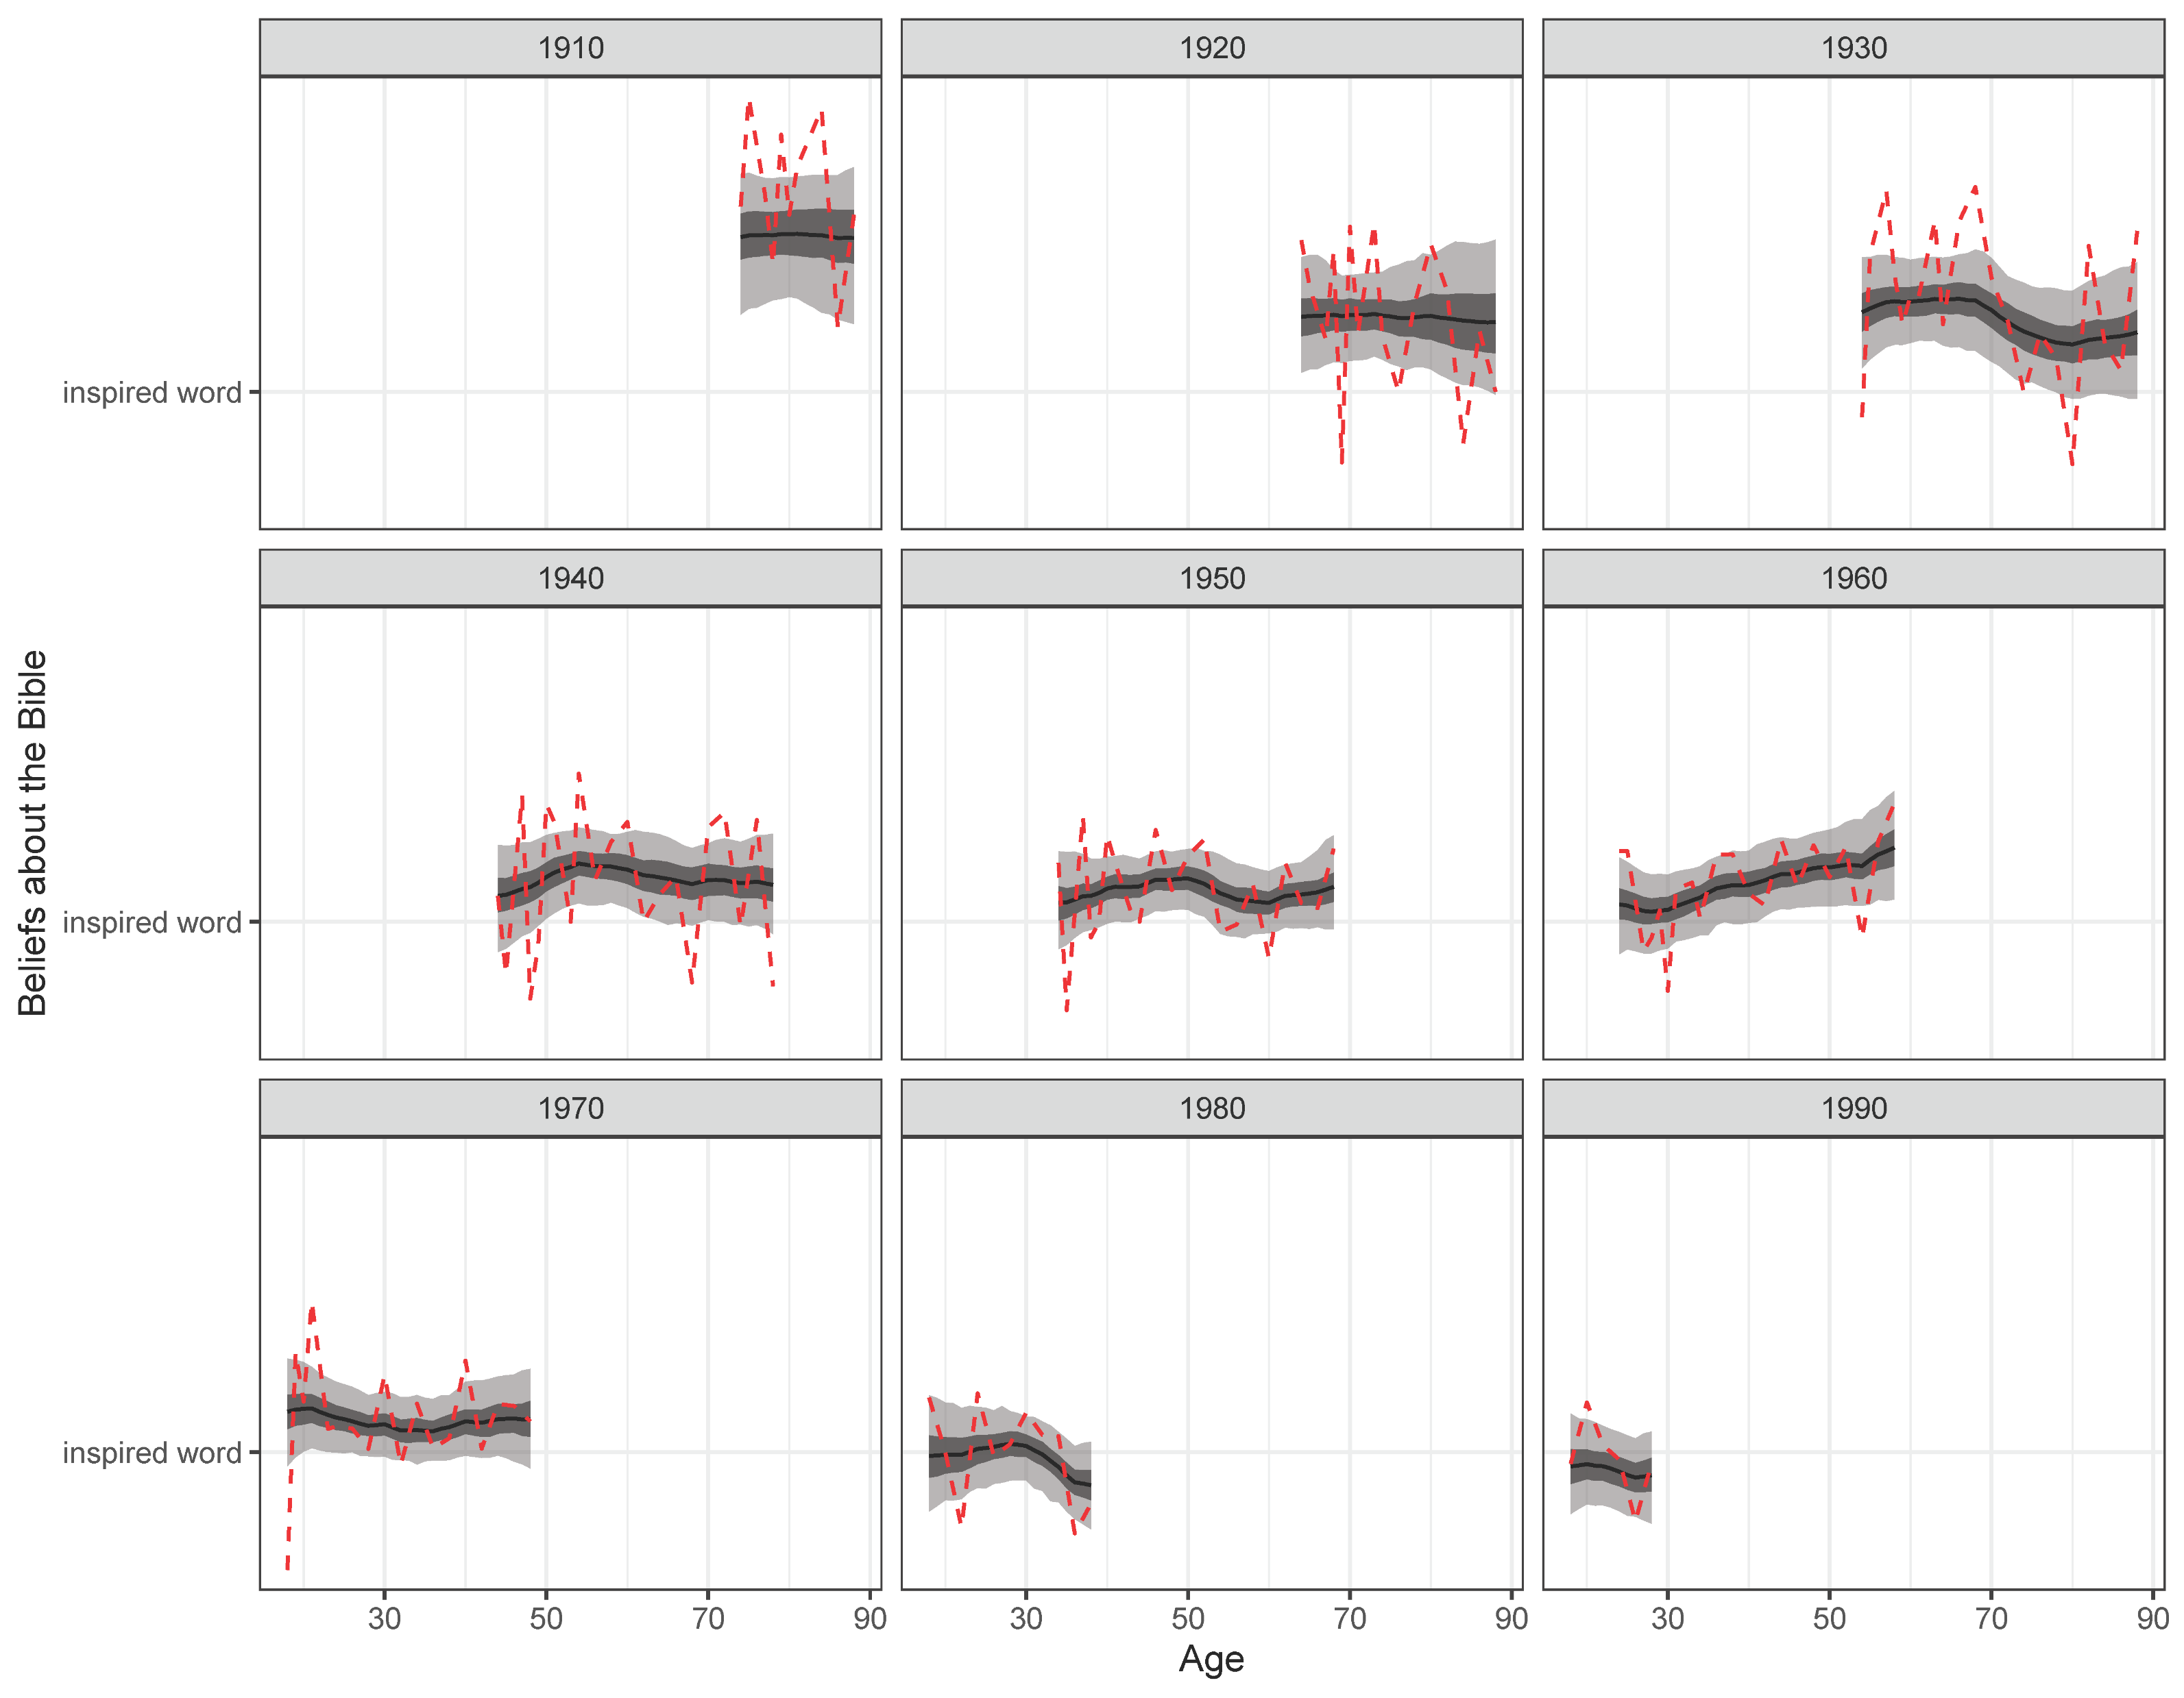

Slide 40
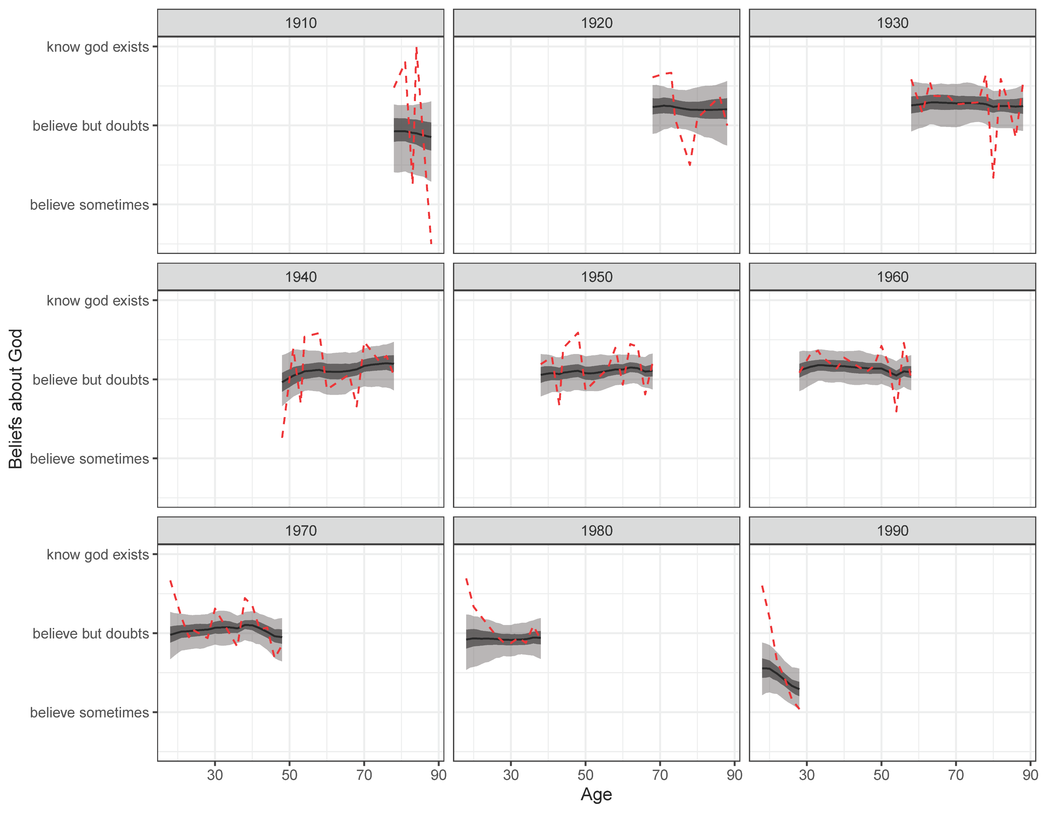

Slide 41
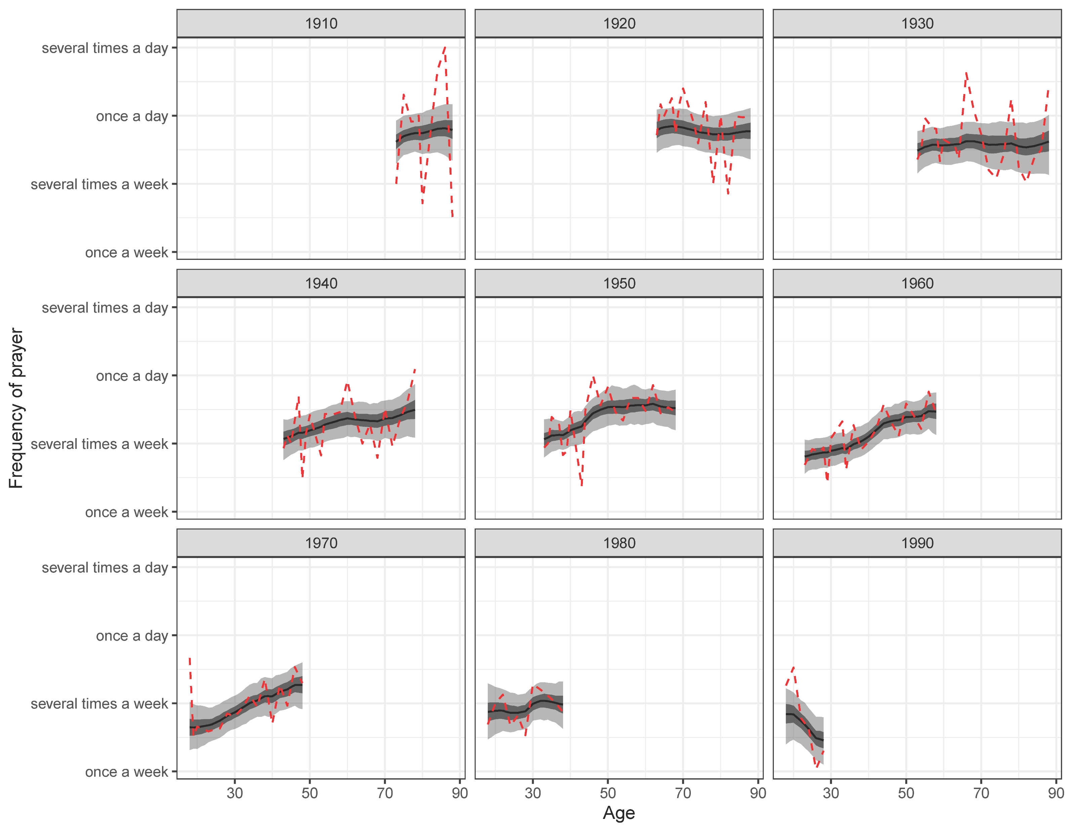

Slide 42
